Slide 1

Parent Functions and Transformations
Unit 1 Lesson 5

Slide 2

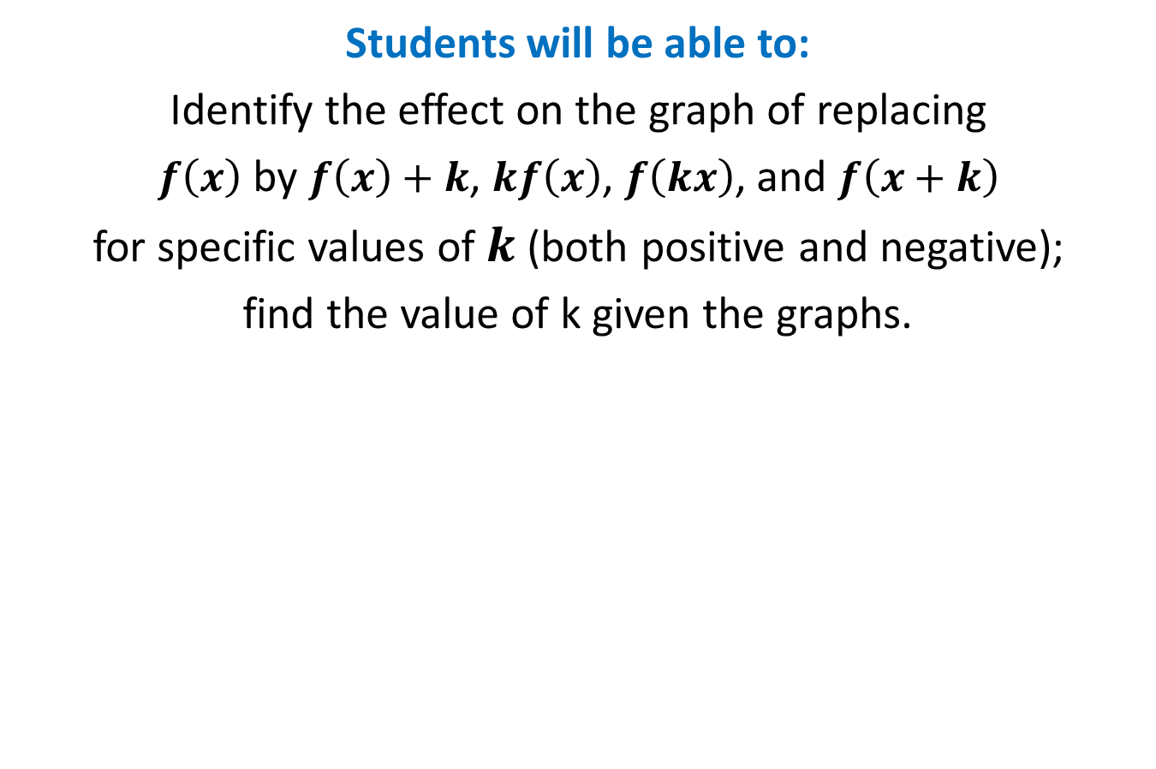
Parent Functions and Transformations
Students will be able to:
Identify the effect on the graph of replacing
$f\left(x\right)$ by $f\left(x\right)+k$, $kf\left(x\right)$, $f\left(kx\right)$, and $f\left(x+k\right)$
for specific values of $k$ (both positive and negative);
find the value of k given the graphs.

Slide 3
Parent Functions and Transformations
Key Vocabulary:
Parent function
Transformation
Translation
Dilation

Slide 4

Parent Functions and Transformations
A family of functions is a group of functions with graphs that display one or more similar characteristics.
The Parent Function is the simplest function with the defining characteristics of the family. Functions in the same family are transformations of their parent functions.

Slide 5
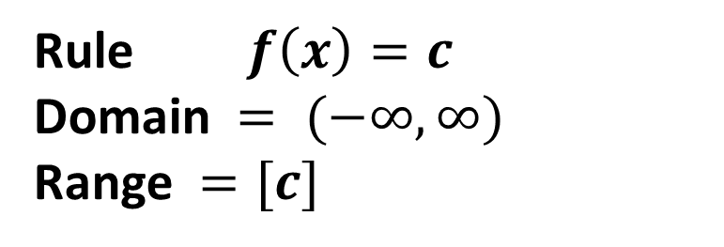
Parent Functions and Transformations
Family - Constant Function
Graph:
Rule $f\left(x\right)=c$
Domain $= (−∞,∞)$
Range $=[c]$

Slide 6
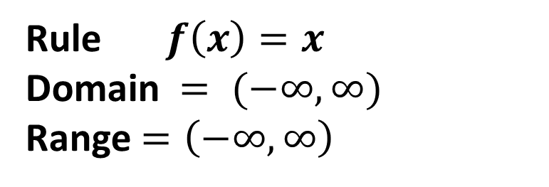
Parent Functions and Transformations
Family - Linear Function
Graph:
Rule$f\left(x\right)=x$
Domain $= (−∞,∞)$
Range$=\left(−∞,∞\right)$

Slide 7
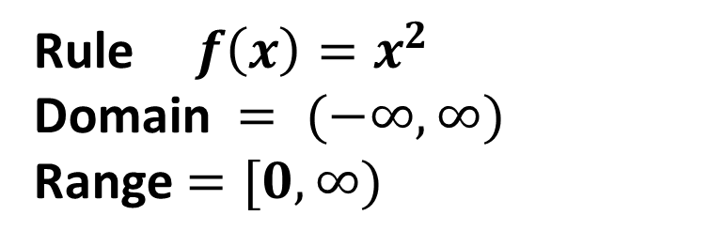
Parent Functions and Transformations
Family - Quadratic Function
Graph:
Rule${ f\left(x\right)=x}^{2}$
Domain $= (−∞,∞)$
Range$=[0,∞)$

Slide 8
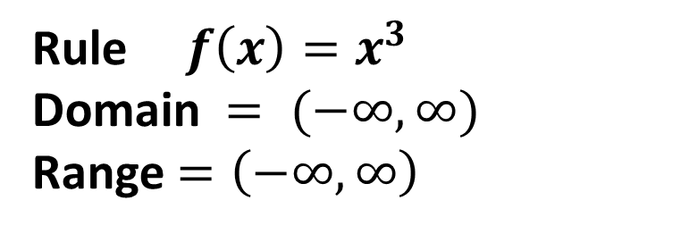
Parent Functions and Transformations
Family - Cubic Function
Graph:
Rule$f\left(x\right)=x^{3}$
Domain $= (−∞,∞)$
Range$=\left(−∞,∞\right)$

Slide 9
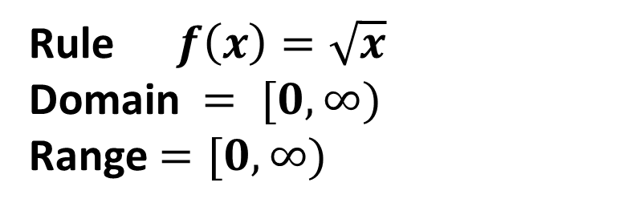
Parent Functions and Transformations
Family - Square Root Function
Graph:
Rule$f\left(x\right)=\sqrt{x}$
Domain $= [0,∞)$
Range$=[0,∞)$

Slide 10
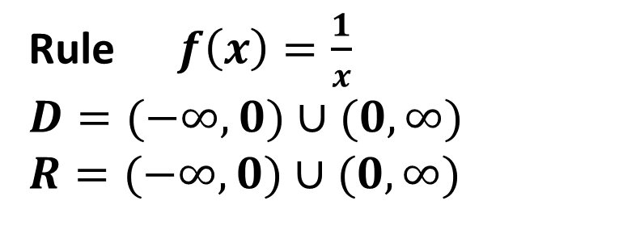
Parent Functions and Transformations
Family - Reciprocal Function
Graph:
Rule$f\left(x\right)=\frac{1}{x}$
$$D=(−∞,0)∪(0,∞)$$
$$R=(−∞,0)∪(0,∞)$$

Slide 11
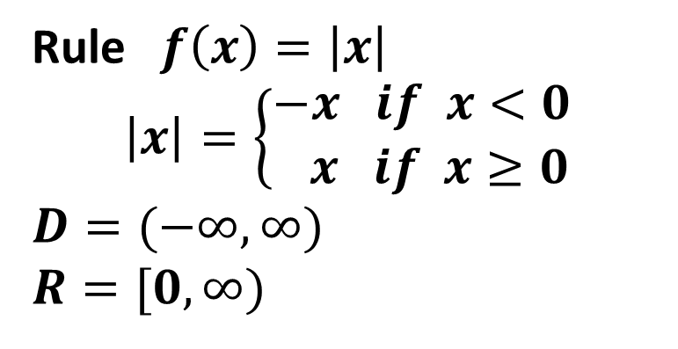
Parent Functions and Transformations
Family - Absolut Value Function
Graph:
Rule$f\left(x\right)=\left|x\right|$
$$\left|x\right|=\left\{\begin{aligned}−x if x<0 \\ x if x≥0\end{aligned}\right.$$
$$D=(−∞,∞)$$
$$R=[0,∞)$$

Slide 12
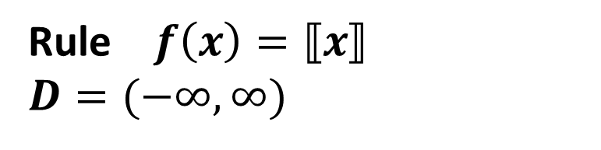
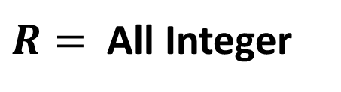
Parent Functions and Transformations
Family - Greatest Integer Function
Graph:
Rule $f\left(x\right)=⟦x⟧$
$$D=(−∞,∞)$$
$R=$ All Integer

Slide 13
Parent Functions and Transformations
Transformations
A change in the size or position of a figure or graph of the function is called a transformation.
Rigid transformations change only the position of the graph, leaving the size and shape unchanged.
Non rigid transformations distort the shape of the graph.

Slide 14
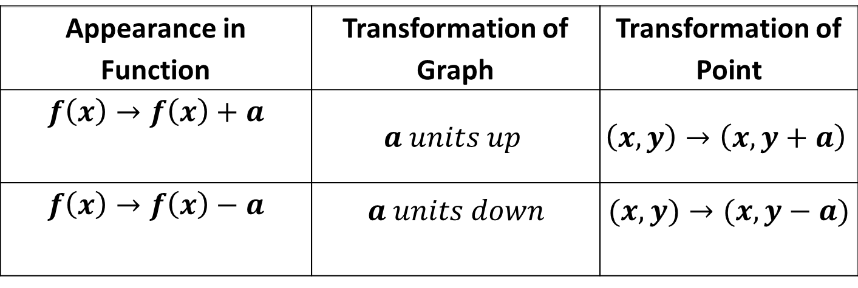
Parent Functions and Transformations
Rigid transformations
Vertical Translations
Appearance in Function | Transformation of Graph | Transformation of Point
$$f\left(x\right)→f\left(x\right)+a$$ | $$a units up$$ | $$\left(x,y\right)→\left(x,y+a\right)$$
$$f\left(x\right)→f\left(x\right)−a$$ | $$a units down$$ | $$(x,y)→(x,y−a)$$

Slide 15
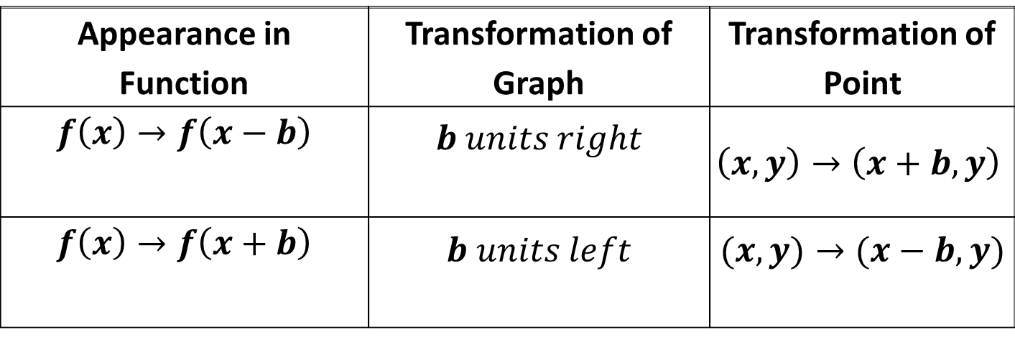
Parent Functions and Transformations
Rigid transformations
Horizontal Translations
Appearance in Function | Transformation of Graph | Transformation of Point
$$f\left(x\right)→f\left(x−b\right)$$ | $$b units right$$ | $$\left(x,y\right)→\left(x+b,y\right)$$
$$f\left(x\right)→f\left(x+b\right)$$ | $$b units left$$ | $$(x,y)→(x−b,y)$$

Slide 16
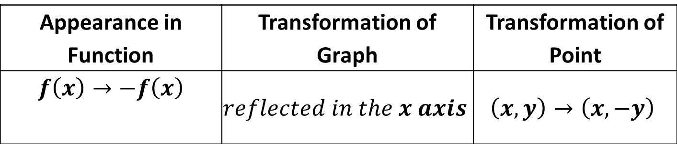
Parent Functions and Transformations
Rigid transformations
Reflections in x-axes
Appearance in Function | Transformation of Graph | Transformation of Point
$$f\left(x\right)→−f\left(x\right)$$ | $$reflected in the x axis$$ | $$\left(x,y\right)→\left(x,−y\right)$$

Slide 17
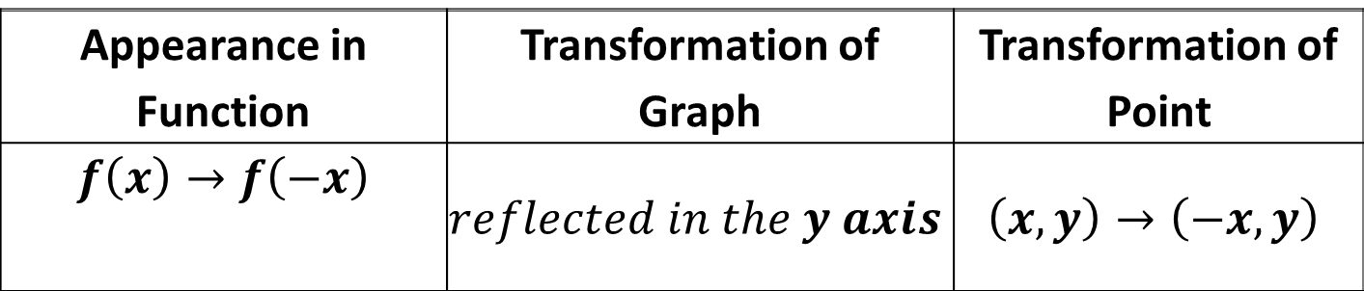
Parent Functions and Transformations
Rigid transformations
Reflections in y-axes
Appearance in Function | Transformation of Graph | Transformation of Point
$$f\left(x\right)→f\left(−x\right)$$ | $$reflected in the y axis$$ | $$\left(x,y\right)→\left(−x,y\right)$$

Slide 18
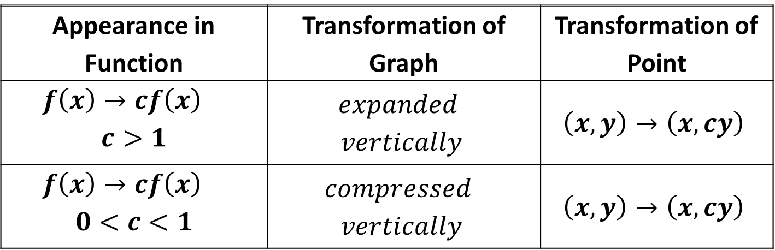
Parent Functions and Transformations
Non rigid transformations
Vertical Dilations
Appearance in Function | Transformation of Graph | Transformation of Point
$$f\left(x\right)→cf\left(x\right)$$ $$c>1$$ | $$expanded$$ $$vertically$$ | $$\left(x,y\right)→\left(x,cy\right)$$
$$f\left(x\right)→cf\left(x\right)$$ $$0<c<1$$ | $$compressed$$ $$vertically$$ | $$\left(x,y\right)→\left(x,cy\right)$$

Slide 19
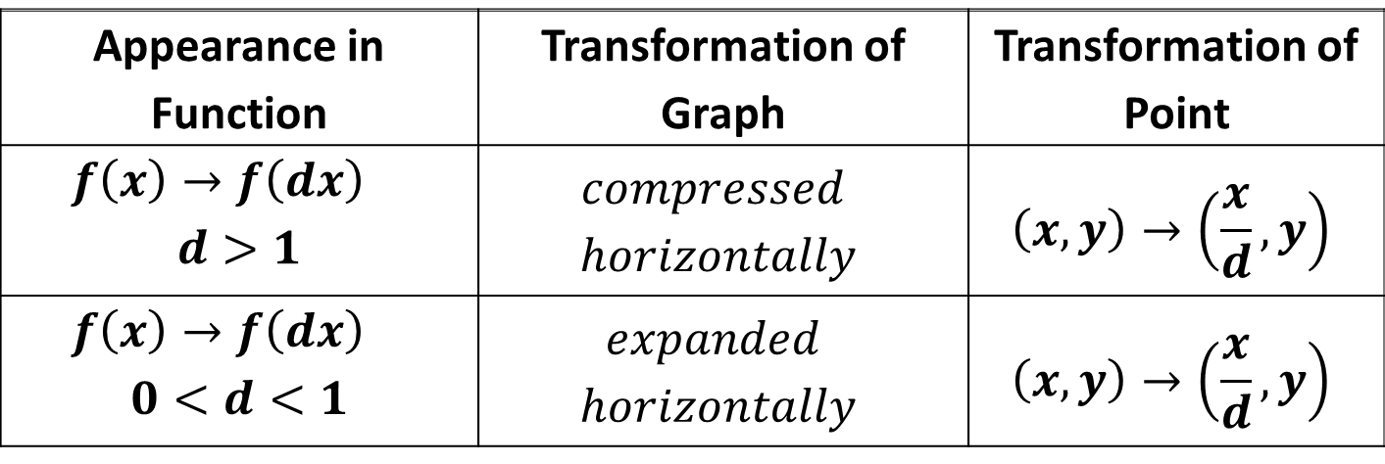
Parent Functions and Transformations
Non rigid transformations
Horizontal Dilations
Appearance in Function | Transformation of Graph | Transformation of Point
$$f\left(x\right)→f\left(dx\right)$$ $$d>1$$ | $$compressed$$ $$horizontally$$ | $$\left(x,y\right)→\left(\frac{x}{d},y\right)$$
$$f\left(x\right)→f\left(dx\right)$$ $$0<d<1$$ | $$expanded$$ $$horizontally$$ | $$\left(x,y\right)→\left(\frac{x}{d},y\right)$$

Slide 20

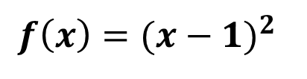
Parent Functions and Transformations
Sample Problem 1: Identify the parent function and describe the transformations.
a.
$${f\left(x\right)=(x−1)}^{2}$$

Slide 21

Parent Functions and Transformations
Sample Problem 1: Identify the parent function and describe the transformations.
a.
$${f\left(x\right)=(x−1)}^{2}$$
Parent : ${ f\left(x\right)=x}^{2}$
Transformation: Translation 1 unit right

Slide 22
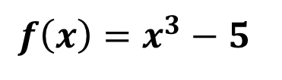
Parent Functions and Transformations
Sample Problem 1: Identify the parent function and describe the transformations.
b.
$$f\left(x\right)=x^{3}−5$$

Slide 23
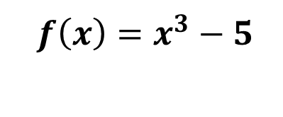
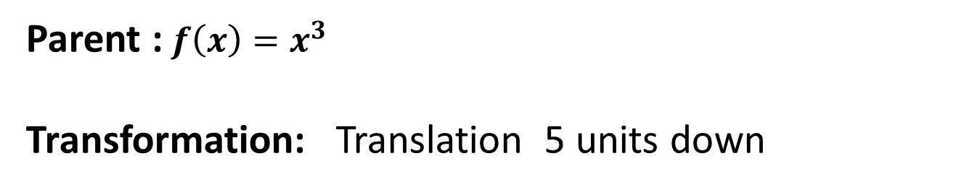
Parent Functions and Transformations
Sample Problem 1: Identify the parent function and describe the transformations.
b.
$$f\left(x\right)=x^{3}−5$$
Parent :$f\left(x\right)=x^{3}$
Transformation: Translation 5 units down

Slide 24
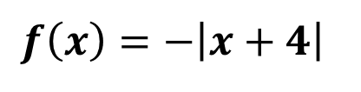
Parent Functions and Transformations
Sample Problem 1: Identify the parent function and describe the transformations.
c.
$$f\left(x\right)=−\left|x+4\right|$$

Slide 25
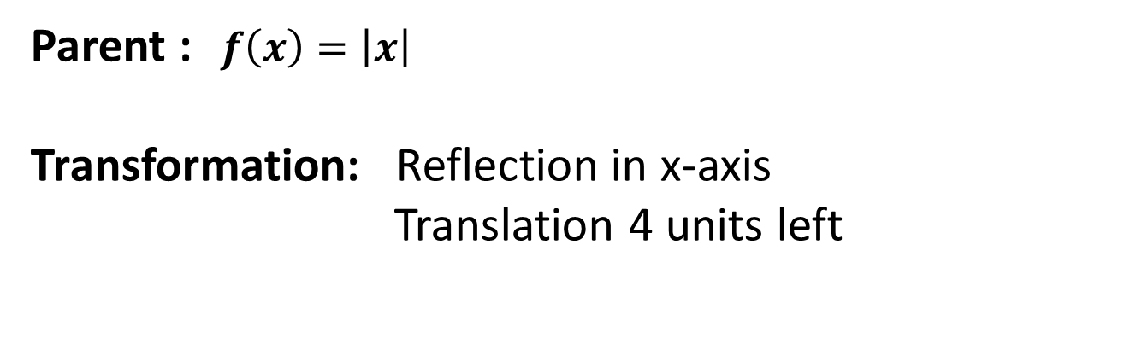
Parent Functions and Transformations
Sample Problem 1: Identify the parent function and describe the transformations.
c.
$$f\left(x\right)=−\left|x+4\right|$$
Parent :$f\left(x\right)=\left|x\right|$
Transformation: Reflection in x-axis
Translation 4 units left

Slide 26
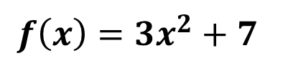
Parent Functions and Transformations
Sample Problem 1: Identify the parent function and describe the transformations.
d.
$$f\left(x\right)=3x^{2}+7$$

Slide 27
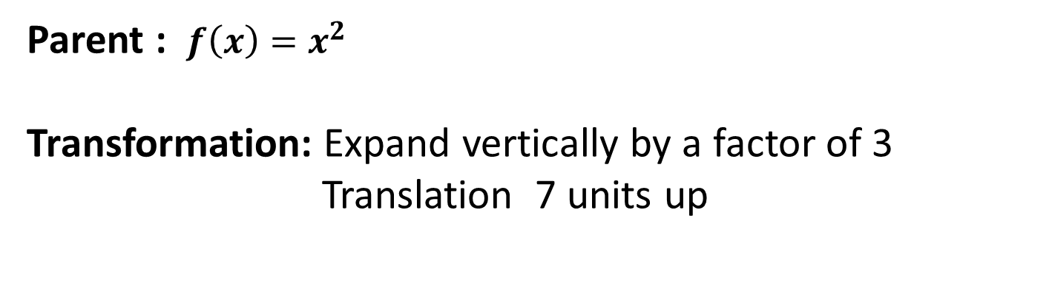
Parent Functions and Transformations
Sample Problem 1: Identify the parent function and describe the transformations.
d.
$$f\left(x\right)=3x^{2}+7$$
Parent : $f\left(x\right)=x^{2}$
Transformation: Expand vertically by a factor of 3
Translation 7 units up

Slide 28
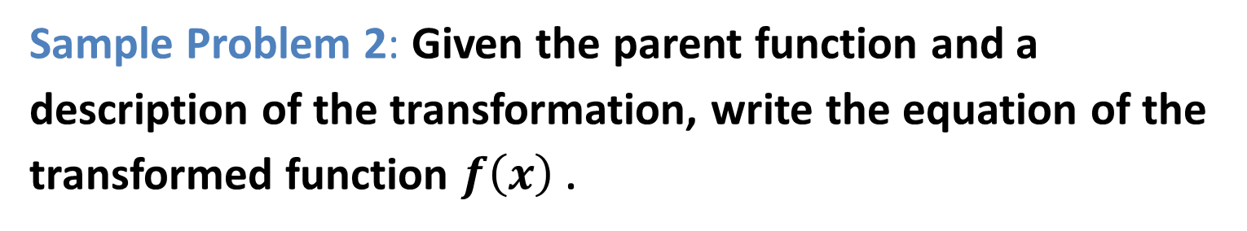
Parent Functions and Transformations
Sample Problem 2: Given the parent function and a description of the transformation, write the equation of the transformed function $f\left(x\right)$ .
a.
Quadratic - expanded horizontally by a factor of 2,
translated 7 units up.

Slide 29
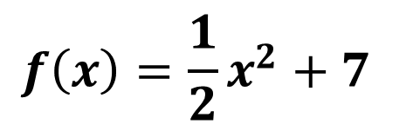
Parent Functions and Transformations
Sample Problem 2: Given the parent function and a description of the transformation, write the equation of the transformed function $f\left(x\right)$ .
a.
Quadratic - expanded horizontally by a factor of 2,
translated 7 units up.
$$f\left(x\right)=\frac{1}{2}x^{2}+7$$

Slide 30
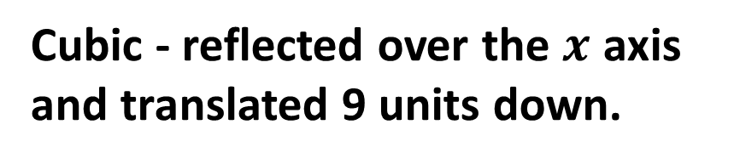
Parent Functions and Transformations
Sample Problem 2: Given the parent function and a description of the transformation, write the equation of the transformed function $f\left(x\right)$ .
b.
Cubic - reflected over the $x$ axis
and translated 9 units down.

Slide 31
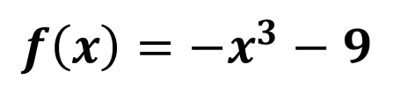
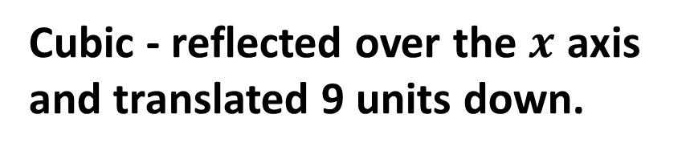
Parent Functions and Transformations
Sample Problem 2: Given the parent function and a description of the transformation, write the equation of the transformed function $f\left(x\right)$ .
b.
Cubic - reflected over the $x$ axis
and translated 9 units down.
$$f\left(x\right)=−x^{3}−9$$

Slide 32
Parent Functions and Transformations
Sample Problem 2: Given the parent function and a description of the transformation, write the equation of the transformed function $f\left(x\right)$ .
c.
Absolute value - translated 3 units up,
translated 8 units’ right.

Slide 33
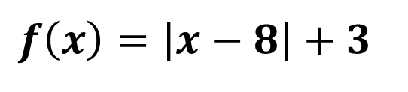
Parent Functions and Transformations
Sample Problem 2: Given the parent function and a description of the transformation, write the equation of the transformed function $f\left(x\right)$ .
c.
Absolute value - translated 3 units up,
translated 8 units right.
$$f\left(x\right)=\left|x−8\right|+3$$

Slide 34
Parent Functions and Transformations
Sample Problem 2: Given the parent function and a description of the transformation, write the equation of the transformed function $f\left(x\right)$ .
d.
Reciprocal - translated 1 unit up.

Slide 35
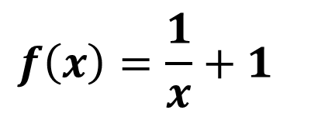
Parent Functions and Transformations
Sample Problem 2: Given the parent function and a description of the transformation, write the equation of the transformed function $f\left(x\right)$ .
d.
Reciprocal - translated 1 unit up.
$$f\left(x\right)=\frac{1}{x}+1$$

Slide 36
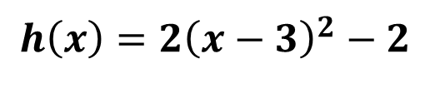
Parent Functions and Transformations
Sample Problem 3: Use the graph of parent function to graph each function. Find the domain and the range of the new function.
a.
$$h\left(x\right)={2\left(x−3\right)}^{2}−2$$

Slide 37
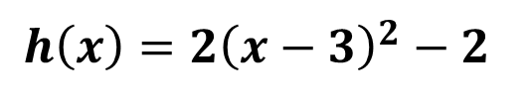
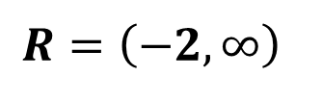
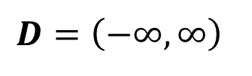
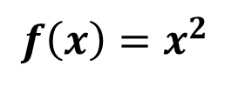
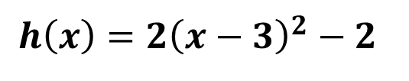
Parent Functions and Transformations
Sample Problem 3: Use the graph of parent function to graph each function. Find the domain and the range of the new function.
a.
$$h\left(x\right)={2\left(x−3\right)}^{2}−2$$
$$h\left(x\right)={2\left(x−3\right)}^{2}−2$$
Parent function
$$f\left(x\right)=x^{2}$$
Transformation:
Compressed horizontally by a factor of 2
Translated 2 units down
Translated 3 units right
$$D=\left(−∞,∞\right)$$
$$R=\left(−2,∞\right)$$

Slide 38
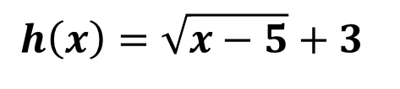
Parent Functions and Transformations
Sample Problem 3: Use the graph of parent function to graph each function. Find the domain and the range of the new function.
b.
$$h\left(x\right)=\sqrt{x−5}+3$$

Slide 39
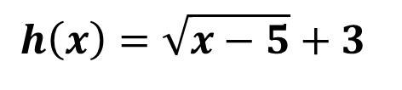
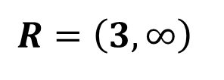
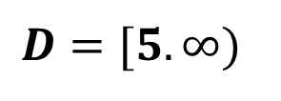
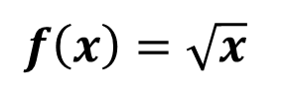
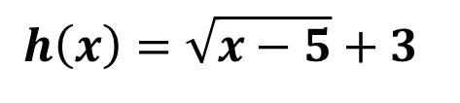
Parent Functions and Transformations
Sample Problem 3: Use the graph of parent function to graph each function. Find the domain and the range of the new function.
b.
$$h\left(x\right)=\sqrt{x−5}+3$$
$$h\left(x\right)=\sqrt{x−5}+3$$
Parent function
$$f\left(x\right)=\sqrt{x}$$
Transformation:
Translated 3 units up
Translated 5 units right
$$D=[5.∞)$$
$$R=\left(3,∞\right)$$

Slide 40
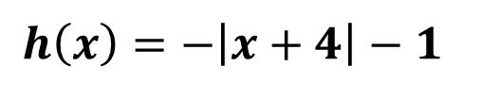
Parent Functions and Transformations
Sample Problem 3: Use the graph of parent function to graph each function. Find the domain and the range of the new function.
c.
$$h\left(x\right)=−\left|x+4\right|−1$$

Slide 41
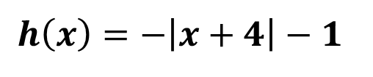
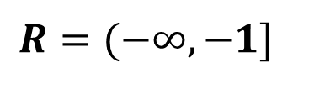
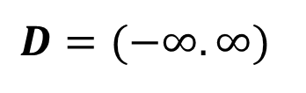
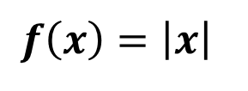
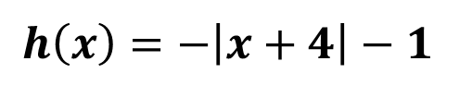
Parent Functions and Transformations
Sample Problem 3: Use the graph of parent function to graph each function. Find the domain and the range of the new function.
c.
$$h\left(x\right)=−\left|x+4\right|−1$$
$$h\left(x\right)=−\left|x+4\right|−1$$
Parent function
$$f\left(x\right)=\left|x\right|$$
Transformation:
Reflected in the x axis
Translated 1 unit down
Translated 4 units left
$$D=(−∞.∞)$$
$$R=(−∞,−1]$$

Slide 42
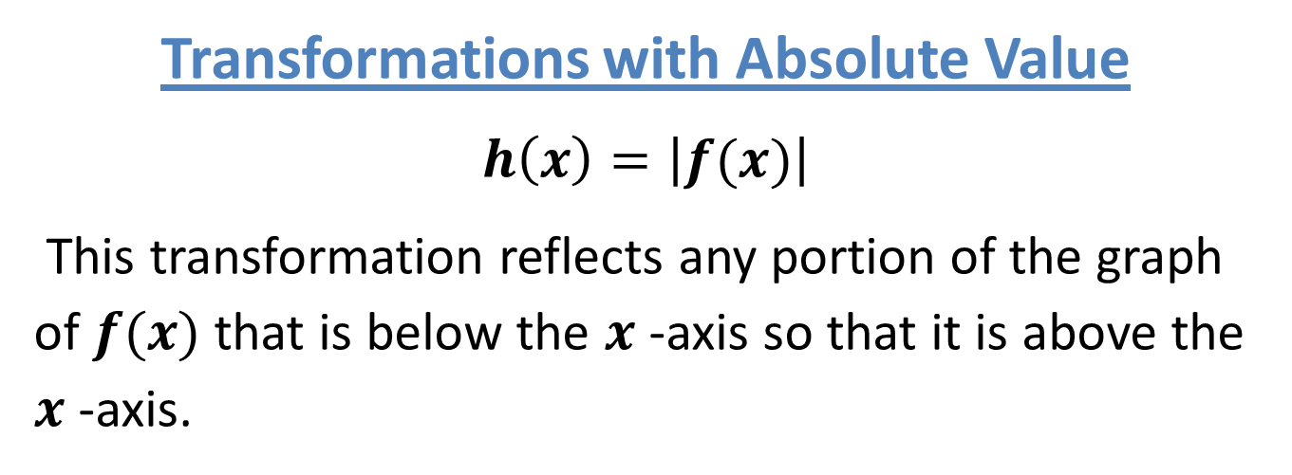
Parent Functions and Transformations
Transformations with Absolute Value
$$h\left(x\right)=\left|f(x)\right|$$
This transformation reflects any portion of the graph of $f(x)$ that is below the $x$ -axis so that it is above the $x$ -axis.

Slide 43

Parent Functions and Transformations
Transformations with Absolute Value
$$h\left(x\right)=f(\left|x\right|)$$
This transformation results, in the portion of the graph of $f\left(x\right)$that is to the left of the $y$-axis, being replaced by a reflection of the portion to the right of the$y$ -axis.

Slide 44

Parent Functions and Transformations
Sample Problem 4: Graph each function.
a.
$$f\left(x\right)=x^{3}−2x Graph h\left(x\right)=\left|x^{3}−2x\right|$$

Slide 45


Parent Functions and Transformations
Sample Problem 4: Graph each function.
a.
$$f\left(x\right)=x^{3}−2x Graph h\left(x\right)=\left|x^{3}−2x\right|$$
$$f\left(x\right)=x^{3}−2x$$

Slide 46

Parent Functions and Transformations
Sample Problem 4: Graph each function.
a.
$$f\left(x\right)=x^{3}−2x Graph h\left(x\right)=\left|x^{3}−2x\right|$$
$$h\left(x\right)=\left|x^{3}−2x\right|$$

Slide 47

Parent Functions and Transformations
Sample Problem 4: Graph each function.
$$f\left(x\right)=\frac{1}{x−3} Graph h\left(x\right)=\frac{1}{\left|x−3\right|}$$
b.

Slide 48


Parent Functions and Transformations
Sample Problem 4: Graph each function.
$$f\left(x\right)=\frac{1}{x−3} Graph h\left(x\right)=\frac{1}{\left|x−3\right|}$$
b.
$$f\left(x\right)=\frac{1}{x−3}$$

Slide 49

Parent Functions and Transformations
Sample Problem 4: Graph each function.
$$f\left(x\right)=\frac{1}{x−3} Graph h\left(x\right)=\frac{1}{\left|x−3\right|}$$
b.
$$h\left(x\right)=\frac{1}{\left|x−3\right|}$$

Slide 50
Parent Functions and Transformations
Graph a Piecewise-Defined Function

Slide 51

Parent Functions and Transformations
Sample Problem 5: Graph each piecewise function.
$$f\left(x\right)=\left\{\begin{aligned}{−x}^{3} if x<0 \\ 3 if 0≤x<1 \\ 2x^{2}−2 if x≥1\end{aligned}\right.$$
a.

Slide 52
Parent Functions and Transformations
Sample Problem 5: Graph each piecewise function.
$$f\left(x\right)=\left\{\begin{aligned}{−x}^{3} if x<0 \\ 3 if 0≤x<1 \\ 2x^{2}−2 if x≥1\end{aligned}\right.$$
a.

Slide 53

Parent Functions and Transformations
Sample Problem 5: Graph each piecewise function.
$$f\left(x\right)=\left\{\begin{aligned}3x^{2} if x≤−1 \\ −2 if −1<x<2 \\ \left|x^{2}−1\right| if x≥2\end{aligned}\right.$$
b.

Slide 54
Parent Functions and Transformations
Sample Problem 5: Graph each piecewise function.
$$f\left(x\right)=\left\{\begin{aligned}3x^{2} if x≤−1 \\ −2 if −1<x<2 \\ \left|x^{2}−1\right| if x≥2\end{aligned}\right.$$
b.

