Slide 1
Inverse Relations and Functions
Unit 1 Lesson 7

Slide 2
Inverse Relations and Functions
Students will be able to:
Find inverse functions.
Solve an equation of the form $f\left(x\right)=c$ for a simple function $f$ that has an inverse and write an expression for the inverse.
Verify by composition that one function is the inverse of another.
Read values of an inverse function from a graph or a table, given that the function has an inverse.
Produce an invertible function from a non-invertible function by restricting the domain.

Slide 3
Inverse Relations and Functions
Key Vocabulary:
Inverse function
One-to one function
Horizontal line test

Slide 4
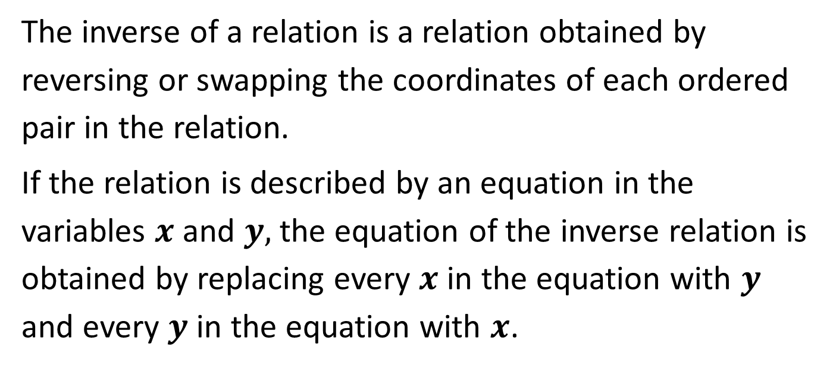
Inverse Relations and Functions
The inverse of a relation is a relation obtained by reversing or swapping the coordinates of each ordered pair in the relation.
If the relation is described by an equation in the variables $x$ and $y,$ the equation of the inverse relation is obtained by replacing every $x$ in the equation with $y$ and every $y$ in the equation with $x$.

Slide 5
Inverse Relations and Functions
If $f\left(x\right)$represents a function of$x$, the inverse of the function is represented by the symbol $f^{−1}\left(x\right)$.
$f^{−1}\left(x\right)≠\frac{1}{f\left(x\right)}$.

Slide 6
Inverse Relations and Functions
Sample Problem 1: Find the inverse of each relation given as a set of ordered pairs.
a.
$$x$$ | $$0$$ | $$1$$ | $$2$$ | $$4$$
$$y$$ | $$−2$$ | $$−3$$ | $$−5$$ | $$−1$$

Slide 7
Inverse Relations and Functions
Sample Problem 1: Find the inverse of each relation given as a set of ordered pairs.
a.
$$x$$ | $$0$$ | $$1$$ | $$2$$ | $$4$$
$$y$$ | $$−2$$ | $$−3$$ | $$−5$$ | $$−1$$
$$x$$ | $$−2$$ | $$−3$$ | $$−5$$ | $$−1$$
$$y$$ | $$0$$ | $$1$$ | $$2$$ | $$4$$

Slide 8
Inverse Relations and Functions
Sample Problem 1: Find the inverse of each relation given as a set of ordered pairs.
b.
$$x$$ | $$−2$$ | $$−5$$ | $$−6$$ | $$1$$
$$y$$ | $$−6$$ | $$−10$$ | $$−3$$ | $$−9$$

Slide 9
Inverse Relations and Functions
Sample Problem 1: Find the inverse of each relation given as a set of ordered pairs.
b.
$$x$$ | $$−2$$ | $$−5$$ | $$−6$$ | $$1$$
$$y$$ | $$−6$$ | $$−10$$ | $$−3$$ | $$−9$$
$$x$$ | $$−6$$ | $$−10$$ | $$−3$$ | $$−9$$
$$y$$ | $$−2$$ | $$−5$$ | $$−6$$ | $$1$$

Slide 10
Inverse Relations and Functions
Horizontal Line Test
A function$f$ has an inverse function $f^{−1}$ if and only if each horizontal line intersects the graph of the function in at most one point.
If a function passes the horizontal line test, then it is said to be one-to-one, because no $x$-value is matched with more than one $y$-value and no $y$-value is matched with more than one $x$ -value.
.

Slide 11
Inverse Relations and Functions
Horizontal Line Test
If a function$f$ is one-to-one, it has an inverse function $f^{−1}$ such that the domain of$f$ is equal to the range of${ f}^{−1}$, and the range of$f$ is equal to the domain of${ f}^{−1}$.
.

Slide 12
Inverse Relations and Functions
Sample Problem 2: Use a horizontal line test to determine whether of the graph of each function is a one-to-one function.
a.
$$f\left(x\right)=x^{2}−2$$

Slide 13
Inverse Relations and Functions
Sample Problem 2: Use a horizontal line test to determine whether of the graph of each function is a one-to-one function.
a.
$$f\left(x\right)=x^{2}−2$$
Because we can draw at least one horizontal line that intersects the graph more than once,
$f\left(x\right)=x^{2}−2$ is not a one-to-one function.
Therefore the inverse of$f\left(x\right)=x^{2}−2$ is a relation, but not a function.

Slide 14
Inverse Relations and Functions
Sample Problem 2: Use a horizontal line test to determine whether of the graph of each function is a one-to-one function.
b.
$$f\left(x\right)=x^{3}+3$$

Slide 15
Inverse Relations and Functions
Sample Problem 2: Use a horizontal line test to determine whether of the graph of each function is a one-to-one function.
b.
$$f\left(x\right)=x^{3}+3$$
Because every horizontal line we draw intersects the graph only once, $f\left(x\right)=x^{3}+3$is a one-to-one function.
Therefore the inverse of $f\left(x\right)=x^{3}+3$
is a function.

Slide 16
Inverse Relations and Functions
Step by Step Procedure to Find the Inverse of $f\left(x\right)$
Determine whether the function has an inverse by checking to see if it is one-to-one.
Replace $f\left(x\right)$with $y.$
Interchange $x$ and $y.$
Solve for$y.$

Slide 17
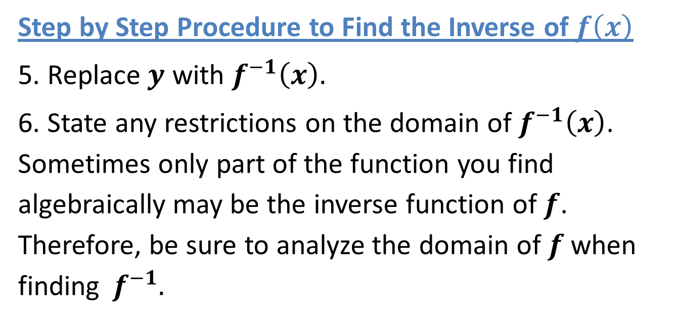
Inverse Relations and Functions
Step by Step Procedure to Find the Inverse of $f\left(x\right)$
5. Replace $y$ with $f^{−1}\left(x\right).$
6. State any restrictions on the domain of $f^{−1}\left(x\right)$. Sometimes only part of the function you find algebraically may be the inverse function of$f$. Therefore, be sure to analyze the domain of$f$ when finding${ f}^{−1}.$

Slide 18
Inverse Relations and Functions
The graphs of the function and the inverse function are reflections across the line $y=x$.

Slide 19
Inverse Relations and Functions
Sample Problem 3: Find the inverse function, state any restrictions on its domain and then graph the function and its inverse.
a.
$$f\left(x\right)=4x−3$$

Slide 20
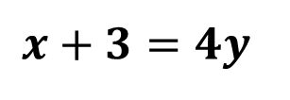
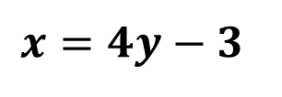
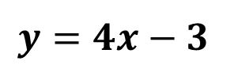
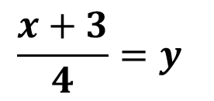
Inverse Relations and Functions
Sample Problem 3: Find the inverse function, state any restrictions on its domain and then graph the function and its inverse.
a.
$$f\left(x\right)=4x−3$$
$$D=(−∞,∞) R= (−∞,∞)$$
$$y=4x−3$$
$$x=4y−3$$
$$x+3=4y−3+3$$
$$x+3=4y$$
$$\frac{x+3}{4}=y$$
$$f^{−1}\left(x\right)=\frac{x+3}{4}$$
$$D=(−∞,∞) R= (−∞,∞)$$

Slide 21
Inverse Relations and Functions
Sample Problem 3: Find the inverse function, state any restrictions on its domain and then graph the function and its inverse.
$$f^{−1}\left(x\right)=\frac{x+3}{4}$$
a.
$$f\left(x\right)=4x−3$$

Slide 22
Inverse Relations and Functions
Sample Problem 3: Find the inverse function, state any restrictions on its domain and then graph the function and its inverse.
b.
$$f\left(x\right)={\left(x−2\right)}^{3}$$

Slide 23
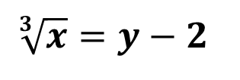
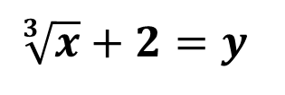
Inverse Relations and Functions
Sample Problem 3: Find the inverse function, state any restrictions on its domain and then graph the function and its inverse.
b.
$$f\left(x\right)={\left(x−2\right)}^{3}$$
$$D=(−∞,∞) R= (−∞,∞)$$
$$y={\left(x−2\right)}^{3}$$
$$x={\left(y−2\right)}^{3}$$
$$\sqrt[3]{x}=\sqrt[3]{{\left(y−2\right)}^{3}}$$
$$\sqrt[3]{x}=y−2$$
$$\sqrt[3]{x}+2=y−2+2$$
$$\sqrt[3]{x}+2=y$$
$$D=(−∞,∞) R= (−∞,∞)$$
$$f^{−1}\left(x\right)=\sqrt[3]{x}+2$$

Slide 24
Inverse Relations and Functions
Sample Problem 3: Find the inverse function, state any restrictions on its domain and then graph the function and its inverse.
b.
$$f\left(x\right)={\left(x−2\right)}^{3}$$
$$f^{−1}\left(x\right)=\sqrt[3]{x}+2$$

Slide 25
Inverse Relations and Functions
Sample Problem 3: Find the inverse function, state any restrictions on its domain and then graph the function and its inverse.
$$f\left(x\right)=2\sqrt{x+1}$$
c.

Slide 26
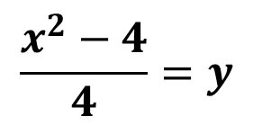
Inverse Relations and Functions
Sample Problem 3: Find the inverse function, state any restrictions on its domain and then graph the function and its inverse.
c.
$$f\left(x\right)=2\sqrt{x+1} D=\left[−1,∞\right) R= \left[0,∞\right)$$
$$y=2\sqrt{x+1}$$
$$x=2\sqrt{y+1}$$
$$x^{2}=2^{2}{\left(\sqrt{y+1}\right)}^{2}$$
$$x^{2}=4\left(y+1\right)$$
$$x^{2}=4y+4$$
$$f^{−1}\left(x\right)=\frac{x^{2}−4}{4} x≥0$$
$$\frac{x^{2}−4}{4}=y$$
$$D=\left[0,∞\right) R= \left[−1,∞\right)$$

Slide 27
Inverse Relations and Functions
Sample Problem 3: Find the inverse function, state any restrictions on its domain and then graph the function and its inverse.
$$f^{−1}\left(x\right)=\frac{x^{2}−4}{4} x≥0$$
$$f\left(x\right)=2\sqrt{x+1}$$
c.

Slide 28
Inverse Relations and Functions
Compositions of Inverse Functions
Two functions, $f$ and$g$, are inverse functions if and only if:
$f\left(g(x)\right)=x,$for every $x$ in the domain of $g(x)$ and
$g\left(f(x)\right)=x,$ for every $x$ in the domain of $f\left(x\right)$.

Slide 29
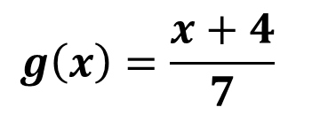
Inverse Relations and Functions
Sample Problem 4: Show algebraically that $f$ and$g$ are inverse functions.
$$g\left(x\right)=\frac{x+4}{7}$$
a.
$$f\left(x\right)=7x−4$$

Slide 30
Inverse Relations and Functions
Sample Problem 4: Show algebraically that $f$ and$g$ are inverse functions.
$$g\left(x\right)=\frac{x+4}{7}$$
a.
$$f\left(x\right)=7x−4$$
$$f\left(g\left(x\right)\right)=7\left(g\left(x\right)\right)−4$$
$$f\left(g\left(x\right)\right)=7\left(\frac{x+4}{7}\right)−4$$
$$f\left(g\left(x\right)\right)=x+4−4$$
$$f\left(g\left(x\right)\right)=x$$

Slide 31
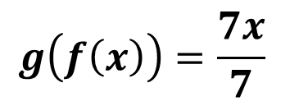
Inverse Relations and Functions
Sample Problem 4: Show algebraically that $f$ and$g$ are inverse functions.
$$g\left(x\right)=\frac{x+4}{7}$$
a.
$$f\left(x\right)=7x−4$$
$$g\left(f\left(x\right)\right)=\frac{f\left(x\right)+4}{7}$$
$$g\left(f\left(x\right)\right)=\frac{7x−4+4}{7}$$
$$g\left(f\left(x\right)\right)=\frac{7x}{7}$$
$$g\left(f\left(x\right)\right)=x$$

Slide 32
Inverse Relations and Functions
Sample Problem 4: Show algebraically that $f$ and$g$ are inverse functions.
b.
$$f\left(x\right)=\sqrt{x+5}−3$$
$$g\left(x\right)=x^{2}+6x+4 x≥3$$

Slide 33
Inverse Relations and Functions
Sample Problem 4: Show algebraically that $f$ and$g$ are inverse functions.
b.
$$f\left(x\right)=\sqrt{x+5}−3$$
$$g\left(x\right)=x^{2}+6x+4 x≥3$$
$$f\left(g\left(x\right)\right)=\sqrt{g\left(x\right)+5}−3$$
$$f\left(g\left(x\right)\right)=\sqrt{x^{2}+6x+4+5}−3$$
$$f\left(g\left(x\right)\right)=\sqrt{x^{2}+6x+9}−3$$
$$f\left(g\left(x\right)\right)=\sqrt{{\left(x+3\right)}^{2}}−3$$
$$f\left(g\left(x\right)\right)=\left(x+3\right)−3$$
$$f\left(g\left(x\right)\right)=x$$

Slide 34
Inverse Relations and Functions
Sample Problem 4: Show algebraically that $f$ and$g$ are inverse functions.
b.
$$f\left(x\right)=\sqrt{x+5}−3$$
$$g\left(x\right)=x^{2}+6x+4 x≥3$$
$$g\left(f\left(x\right)\right)={\left(f\left(x\right)\right)}^{2}+6∗f\left(x\right)+4$$
$$g\left(f\left(x\right)\right)={\left(\sqrt{x+5}−3\right)}^{2}+6∗(\sqrt{x+5}−3)+4$$
$$g\left(f\left(x\right)\right)=x+5−6\sqrt{x+5}+9+6\sqrt{x+5}−18+4$$
$$g\left(f\left(x\right)\right)=x$$

