Slide 1
Function Operations and Composition of Functions
Unit 1 Lesson 6

Slide 2
Function Operations and Composition of Functions
Students will be able to:
Combine standard function types using arithmetic operations
Compose functions
Key Vocabulary:
Function operation
Composition of function
Decomposition of Composite Functions
Domain of composite function

Slide 3
Function Operations and Composition of Functions
Function Operations
Let $f$ and $g$ be any two functions. You can add, subtract, multiply or divide $f\left(x\right)$ and $g(x)$ to form a new function.
The domain of new function consist of the $x$ -values that are in the domains of both $f\left(x\right)$ and $g(x)$.
When new function involves division, the domain does not include$x$ -values for which the denominator is equal to zero.

Slide 4
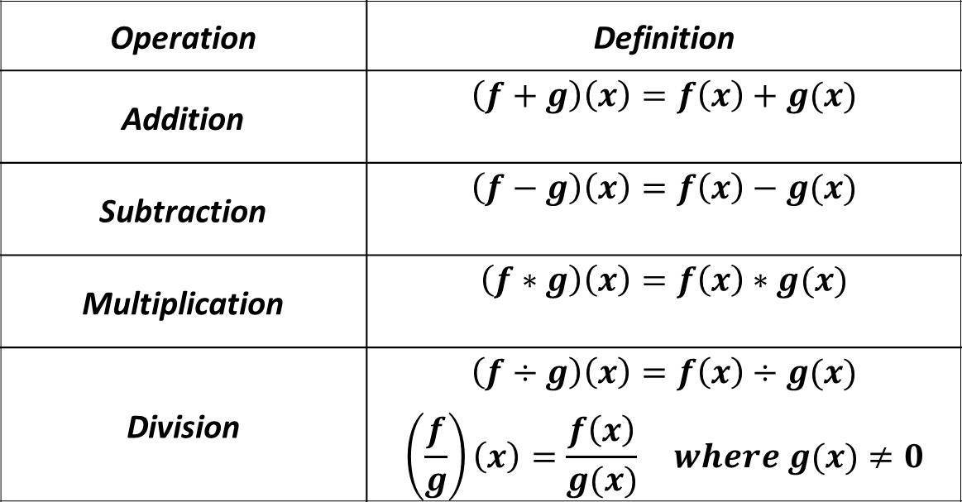
Function Operations and Composition of Functions
Operation | Definition
Addition | $$\left(f+g\right)\left(x\right)=f\left(x\right)+g(x)$$
Subtraction | $$\left(f−g\right)\left(x\right)=f\left(x\right)−g(x)$$
Multiplication | $$\left(f∗g\right)\left(x\right)=f\left(x\right)∗g(x)$$
Division | $$\left(f÷g\right)\left(x\right)=f\left(x\right)÷g(x)$$ $$\left(\frac{f}{g}\right)\left(x\right)=\frac{f\left(x\right)}{g(x)} where g(x)≠0$$

Slide 5
Function Operations and Composition of Functions
Sample Problem 1: : Find $\left(f+g\right)\left(x\right), \left(f−g\right)\left(x\right),\left(f∗g\right)\left(x\right),$ and $\left(\frac{f}{g}\right)\left(x\right)$for each $f\left(x\right)$ and $g(x)$. Determine the domain of each new function.
a.
$$f\left(x\right)=x^{2}+2x−1$$
$$g\left(x\right)=x−5$$

Slide 6
Function Operations and Composition of Functions
Sample Problem 1: : Find $\left(f+g\right)\left(x\right), \left(f−g\right)\left(x\right),\left(f∗g\right)\left(x\right),$ and $\left(\frac{f}{g}\right)\left(x\right)$for each $f\left(x\right)$ and $g(x)$. Determine the domain of each new function.
a.
$$f\left(x\right)=x^{2}+2x−1$$
$$g\left(x\right)=x−5$$
$$\left(f+g\right)\left(x\right)={(x}^{2}+2x−1)+(x−5)$$
$$\left(f+g\right)\left(x\right)=x^{2}+3x−6$$
$$D_{f+g}=(−∞,∞)$$

Slide 7
Function Operations and Composition of Functions
Sample Problem 1: : Find $\left(f+g\right)\left(x\right), \left(f−g\right)\left(x\right),\left(f∗g\right)\left(x\right),$ and $\left(\frac{f}{g}\right)\left(x\right)$for each $f\left(x\right)$ and $g(x)$. Determine the domain of each new function.
a.
$$f\left(x\right)=x^{2}+2x−1$$
$$g\left(x\right)=x−5$$
$$\left(f−g\right)\left(x\right)={(x}^{2}+2x−1)−\left(x−5\right)$$
$$\left(f−g\right)\left(x\right)=x^{2}+2x−1−x+5$$
$$\left(f−g\right)\left(x\right)=x^{2}+x+4$$
$$D_{f−g}=(−∞,∞)$$

Slide 8
Function Operations and Composition of Functions
Sample Problem 1: : Find $\left(f+g\right)\left(x\right), \left(f−g\right)\left(x\right),\left(f∗g\right)\left(x\right),$ and $\left(\frac{f}{g}\right)\left(x\right)$for each $f\left(x\right)$ and $g(x)$. Determine the domain of each new function.
a.
$$f\left(x\right)=x^{2}+2x−1$$
$$g\left(x\right)=x−5$$
$$\left(f∗g\right)\left(x\right)={(x}^{2}+2x−1)∗(x−5)$$
$$\left(f∗g\right)\left(x\right)=x^{3}−3x^{2}−11x+5$$
$$D_{f∗g}=\left(−∞,∞\right)$$

Slide 9
Function Operations and Composition of Functions
Sample Problem 1: : Find $\left(f+g\right)\left(x\right), \left(f−g\right)\left(x\right),\left(f∗g\right)\left(x\right),$ and $\left(\frac{f}{g}\right)\left(x\right)$for each $f\left(x\right)$ and $g(x)$. Determine the domain of each new function.
a.
$$f\left(x\right)=x^{2}+2x−1$$
$$g\left(x\right)=x−5$$
$$\left(\frac{f}{g}\right)\left(x\right)=\frac{x^{2}+2x−1 }{x−5}$$
$$D_{\frac{f}{g}}=(−∞,5)∪(5,∞)$$

Slide 10
Function Operations and Composition of Functions
Sample Problem 1: : Find $\left(f+g\right)\left(x\right), \left(f−g\right)\left(x\right),\left(f∗g\right)\left(x\right),$ and $\left(\frac{f}{g}\right)\left(x\right)$for each $f\left(x\right)$ and $g(x)$. Determine the domain of each new function.
b.
$$f\left(x\right)=x^{2}−81$$
$$g\left(x\right)=x+9$$

Slide 11
Function Operations and Composition of Functions
Sample Problem 1: : Find $\left(f+g\right)\left(x\right), \left(f−g\right)\left(x\right),\left(f∗g\right)\left(x\right),$ and $\left(\frac{f}{g}\right)\left(x\right)$for each $f\left(x\right)$ and $g(x)$. Determine the domain of each new function.
b.
$$f\left(x\right)=x^{2}−81$$
$$g\left(x\right)=x+9$$
$$\left(f+g\right)\left(x\right)=(x^{2}−81) +(x+9)$$
$$\left(f+g\right)\left(x\right)=x^{2}+x−72$$
$$D_{f+g}=(−∞,∞)$$

Slide 12
Function Operations and Composition of Functions
Sample Problem 1: : Find $\left(f+g\right)\left(x\right), \left(f−g\right)\left(x\right),\left(f∗g\right)\left(x\right),$ and $\left(\frac{f}{g}\right)\left(x\right)$for each $f\left(x\right)$ and $g(x)$. Determine the domain of each new function.
b.
$$f\left(x\right)=x^{2}−81$$
$$g\left(x\right)=x+9$$
$$\left(f−g\right)\left(x\right)={(x}^{2}−81)−\left(x+9\right)$$
$$\left(f−g\right)\left(x\right)=x^{2}−81−x−9$$
$$\left(f−g\right)\left(x\right)=x^{2}−x−90$$
$$D_{f−g}=(−∞,∞)$$

Slide 13
Function Operations and Composition of Functions
Sample Problem 1: : Find $\left(f+g\right)\left(x\right), \left(f−g\right)\left(x\right),\left(f∗g\right)\left(x\right),$ and $\left(\frac{f}{g}\right)\left(x\right)$for each $f\left(x\right)$ and $g(x)$. Determine the domain of each new function.
b.
$$f\left(x\right)=x^{2}−81$$
$$g\left(x\right)=x+9$$
$$\left(f∗g\right)\left(x\right)={(x}^{2}−81)∗(x+9)$$
$$\left(f∗g\right)\left(x\right)=x^{3}+9x^{2}−81x−729$$
$$D_{f∗g}=(−∞,∞)$$

Slide 14
Function Operations and Composition of Functions
Sample Problem 1: : Find $\left(f+g\right)\left(x\right), \left(f−g\right)\left(x\right),\left(f∗g\right)\left(x\right),$ and $\left(\frac{f}{g}\right)\left(x\right)$for each $f\left(x\right)$ and $g(x)$. Determine the domain of each new function.
b.
$$f\left(x\right)=x^{2}−81$$
$$g\left(x\right)=x+9$$
$$\left(\frac{f}{g}\right)\left(x\right)=\frac{x^{2}−81 }{x+9}=\frac{(x+9)(x−9) }{x+9}$$
$$\left(\frac{f}{g}\right)=x−9$$
If the function can be simplified, determine the domain before simplifying!
$$D_{\frac{f}{g}}=(−∞,−9)∪(−9,∞)$$

Slide 15
Function Operations and Composition of Functions
Composition of Functions
The composition of function$f$ with function $g$is defined by $\left(f∘g\right)\left(x\right)=f\left(g(x)\right)$
The domain of the composite function$f∘g$ is the set of all such that:
1. $x$ is in the domain of$g$ and
2. $g\left(x\right)$is in the domain of $f$.

Slide 16
Function Operations and Composition of Functions
$$x must be in the domain of g$$
$$x g g\left(x\right) f f(g\left(x\right))$$
$$g\left(x\right) must be in the domain of f$$

Slide 17
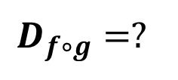
Function Operations and Composition of Functions
Sample Problem 2: Find each composite function. Determine the domain of each composite function.
a.
$$f\left(x\right)=2x−3$$
$$g\left(x\right)=x+1$$
$$\left(f∘g\right)\left(x\right)=?$$
$$D_{f∘g}=?$$

Slide 18
Function Operations and Composition of Functions
Sample Problem 2: Find each composite function. Determine the domain of each composite function.
a.
$$f\left(x\right)=2x−3$$
$$g\left(x\right)=x+1$$
$$\left(f∘g\right)\left(x\right)=?$$
$$D_{f∘g}=?$$
$$\left(f∘g\right)\left(x\right)=f\left(g\left(x\right)\right)$$
$$f\left(g\left(x\right)\right)=2\left(g\left(x\right)\right)−3$$
$$f\left(g\left(x\right)\right)=2\left(x+1\right)−3$$
$$D_{f∘g}=(−∞,∞)$$
$$f\left(g\left(x\right)\right)=2x+2−3$$
$$f\left(g\left(x\right)\right)=2x−1$$

Slide 19
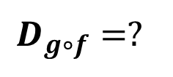
Function Operations and Composition of Functions
Sample Problem 2: Find each composite function. Determine the domain of each composite function.
b.
$$f\left(x\right)=x−3$$
$$g\left(x\right)=x^{2}+1$$
$$\left(g∘f\right)\left(x\right)=?$$
$$D_{g∘f}=?$$

Slide 20
Function Operations and Composition of Functions
Sample Problem 2: Find each composite function. Determine the domain of each composite function.
b.
$$f\left(x\right)=x−3$$
$$g\left(x\right)=x^{2}+1$$
$$\left(g∘f\right)\left(x\right)=?$$
$$D_{g∘f}=?$$
$$\left(g∘f\right)\left(x\right)=g\left(f\left(x\right)\right)$$
$$g\left(f\left(x\right)\right)={\left(f\left(x\right)\right)}^{2}+1$$
$$D_{g∘f}=(−∞,∞)$$
$$g\left(f\left(x\right)\right)={\left(x−3\right)}^{2}+1$$
$$g\left(f\left(x\right)\right)=x^{2}−6x+9+1$$
$$g\left(f\left(x\right)\right)=x^{2}−6x+10$$

Slide 21
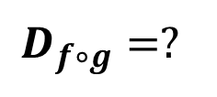
Function Operations and Composition of Functions
Sample Problem 2: Find each composite function. Determine the domain of each composite function.
$$f\left(x\right)=\frac{2}{x−3} g\left(x\right)=\frac{1}{x}$$
c.
$$\left(f∘g\right)\left(x\right)=?$$
$$D_{f∘g}=?$$

Slide 22
Function Operations and Composition of Functions
Sample Problem 2: Find each composite function. Determine the domain of each composite function.
$$f\left(x\right)=\frac{2}{x−3} g\left(x\right)=\frac{1}{x}$$
c.
$$\left(f∘g\right)\left(x\right)=?$$
$$\left(f∘g\right)\left(x\right)=f\left(g\left(x\right)\right)$$
$$f\left(g\left(x\right)\right)=\frac{2}{g\left(x\right)−3} \frac{1}{x}≠0 x≠0$$
$$f\left(g\left(x\right)\right)=\frac{2}{\frac{1}{x}−3} \frac{1}{x}−3≠0 x≠\frac{1}{3}$$
$$f\left(g\left(x\right)\right)=\frac{2x}{1−3x}$$

Slide 23
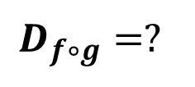
Function Operations and Composition of Functions
Sample Problem 2: Find each composite function. Determine the domain of each composite function.
$$f\left(x\right)=\frac{2}{x−3} g\left(x\right)=\frac{1}{x}$$
c.
$$D_{f∘g}=?$$
$$D_{g}=(−∞,0)∪(0,∞)$$
$$D_{f∘g}=(−∞,0)∪(0,\frac{1}{3})∪(\frac{1}{3},∞)$$

Slide 24
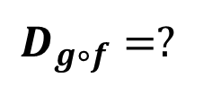
Function Operations and Composition of Functions
Sample Problem 2: Find each composite function. Determine the domain of each composite function.
$$f\left(x\right)=\frac{2}{x} g\left(x\right)=\frac{1}{x}$$
d.
$$\left(g∘f\right)\left(x\right)=?$$
$$D_{g∘f}=?$$

Slide 25
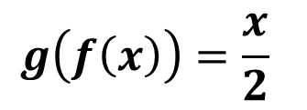
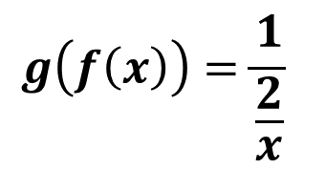
Function Operations and Composition of Functions
Sample Problem 2: Find each composite function. Determine the domain of each composite function.
$$f\left(x\right)=\frac{2}{x} g\left(x\right)=\frac{1}{x}$$
d.
$$\left(g∘f\right)\left(x\right)=?$$
$$\left(g∘f\right)\left(x\right)=g\left(f\left(x\right)\right)$$
$$g\left(f\left(x\right)\right)=\frac{1}{f\left(x\right)} \frac{2}{x}≠0 x≠0$$
$$g\left(f\left(x\right)\right)=\frac{1}{\frac{2}{x}}$$
$$g\left(f\left(x\right)\right)=\frac{x}{2}$$

Slide 26
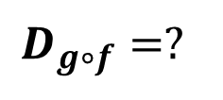
Function Operations and Composition of Functions
Sample Problem 2: Find each composite function. Determine the domain of each composite function.
$$f\left(x\right)=\frac{2}{x} g\left(x\right)=\frac{1}{x}$$
d.
$$D_{g∘f}=?$$
$$D_{g}=(−∞,0)∪(0,∞)$$
$$D_{g∘f}=(−∞,0)∪(0,∞)$$

Slide 27
Function Operations and Composition of Functions
Sample Problem 3: : Find and then evaluate each composite function.
a.
$$f\left(x\right)=\sqrt{x} g\left(x\right)=x−2$$
$$\left(f∘g\right)\left(6\right)=?$$

Slide 28
Function Operations and Composition of Functions
Sample Problem 3: : Find and then evaluate each composite function.
a.
$$f\left(x\right)=\sqrt{x} g\left(x\right)=x−2$$
$$\left(f∘g\right)\left(6\right)=?$$
$$\left(f∘g\right)\left(x\right)=f\left(g\left(x\right)\right)$$
$$f\left(g\left(6\right)\right)=\sqrt{6−2}$$
$$f\left(g\left(x\right)\right)=\sqrt{g\left(x\right)}$$
$$f\left(g\left(6\right)\right)=\sqrt{4}$$
$$f\left(g\left(x\right)\right)=\sqrt{x−2}$$
$$f\left(g\left(6\right)\right)=2$$

Slide 29
Function Operations and Composition of Functions
Sample Problem 3: : Find and then evaluate each composite function.
$$f\left(x\right)=6x−1 g\left(x\right)=\frac{x+3}{2} \left(g∘f\right)\left(2\right)=?$$
b.

Slide 30
Function Operations and Composition of Functions
Sample Problem 3: : Find and then evaluate each composite function.
$$f\left(x\right)=6x−1 g\left(x\right)=\frac{x+3}{2} \left(g∘f\right)\left(2\right)=?$$
b.
$$\left(g∘f\right)\left(x\right)=g\left(f\left(x\right)\right)$$
$$g\left(f\left(x\right)\right)=\frac{f\left(x\right)+3}{2}$$
$$g\left(f\left(2\right)\right)=3∗2+1$$
$$g\left(f\left(x\right)\right)=\frac{(6x−1) +3}{2}$$
$$g\left(f\left(2\right)\right)=7$$
$$g\left(f\left(x\right)\right)=\frac{6x+2}{2}=\frac{2(3x+1)}{2}$$
$$g\left(f\left(x\right)\right)=3x+1$$

Slide 31
Function Operations and Composition of Functions
Decomposition of Composite Functions
When you form a composite function, you “compose” two functions to form a new function. It is also possible to reverse this process. You can “decompose” a given function and express it as a composition of two functions. Although there is more than one way to do this, there is often a “natural” selection that comes to mind first.

Slide 32
Function Operations and Composition of Functions
Sample Problem 4: Express$h\left(x\right)$ as a composition of two functions $f$ and $g$ $\left(f∘g\right)\left(x\right)$.
a.
$$h\left(x\right)={\left(x^{3}−3x\right)}^{2}$$

Slide 33
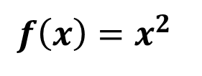
Function Operations and Composition of Functions
Sample Problem 4: Express$h\left(x\right)$ as a composition of two functions $f$ and $g$ $\left(f∘g\right)\left(x\right)$.
a.
$$h\left(x\right)={\left(x^{3}−3x\right)}^{2}$$
$$h\left(x\right)=\left(f∘g\right)\left(x\right)=f\left(g\left(x\right)\right)$$
$$f\left(g\left(x\right)\right)={\left(g\left(x\right)\right)}^{2}={\left(x^{3}−3x\right)}^{2}$$
$$f\left(x\right)=x^{2}$$
$$g\left(x\right)=x^{3}−3x$$

Slide 34
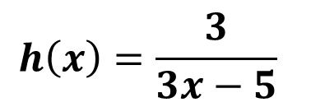
Function Operations and Composition of Functions
Sample Problem 4: Express$h\left(x\right)$ as a composition of two functions $f$ and $g$ $\left(f∘g\right)\left(x\right)$.
$$h\left(x\right)=\frac{3}{3x−5}$$
b.

Slide 35
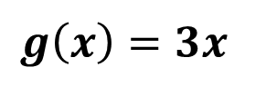
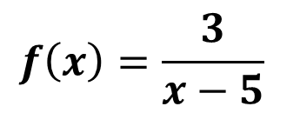
Function Operations and Composition of Functions
Sample Problem 4: Express$h\left(x\right)$ as a composition of two functions $f$ and $g$ $\left(f∘g\right)\left(x\right)$.
$$h\left(x\right)=\frac{3}{3x−5}$$
b.
$$h\left(x\right)=\left(f∘g\right)\left(x\right)=f\left(g\left(x\right)\right)$$
$$f\left(g\left(x\right)\right)=\frac{3}{g\left(x\right)−5}=\frac{3}{3x−5}$$
$$f\left(x\right)=\frac{3}{x−5}$$
$$g\left(x\right)=3x$$

