Slide 1

Continuity, End Behavior, and Limits
Unit 1 Lesson 3

Slide 2

Continuity, End Behavior, and Limits
Students will be able to:
Interpret key features of graphs and tables in terms of the quantities, and sketch graphs showing key features given a verbal description of the relationship.
Key Vocabulary:
Discontinuity,
A limit,
End Behavior

Slide 3

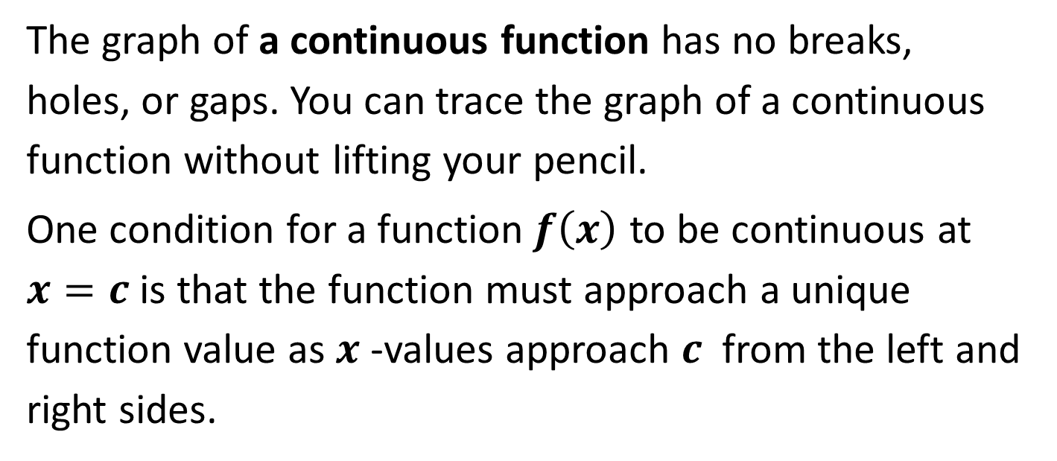
Continuity, End Behavior, and Limits
The graph of a continuous function has no breaks, holes, or gaps. You can trace the graph of a continuous function without lifting your pencil.
One condition for a function$f\left(x\right)$ to be continuous at $x=c$ is that the function must approach a unique function value as $x$ -values approach $c$ from the left and right sides.

Slide 4
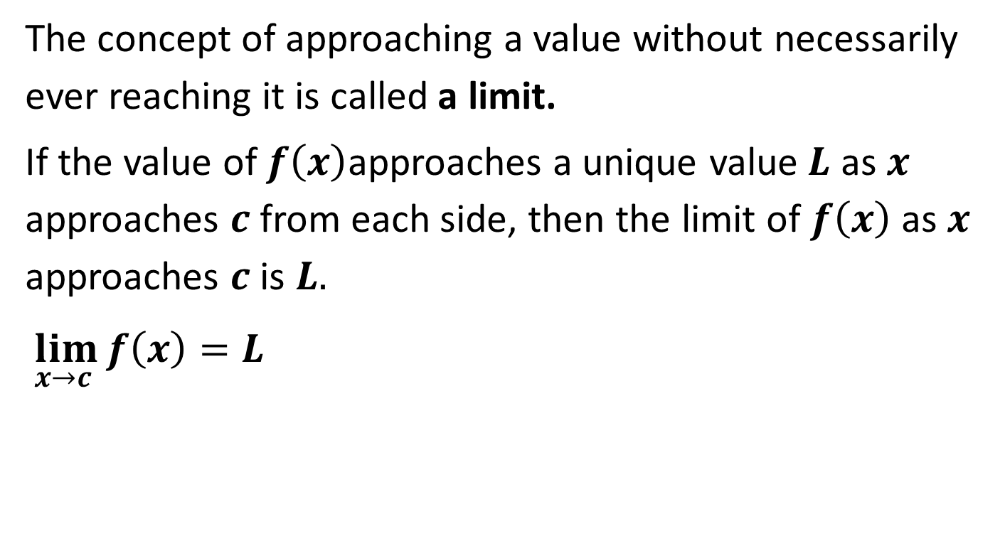
Continuity, End Behavior, and Limits
The concept of approaching a value without necessarily ever reaching it is called a limit.
If the value of $f\left(x\right)$approaches a unique value$L$ as $x$ approaches $c$ from each side, then the limit of $f\left(x\right)$as $x$ approaches $c$ is $L.$
$\lim_{x→c }{f\left(x\right)=L}$

Slide 5
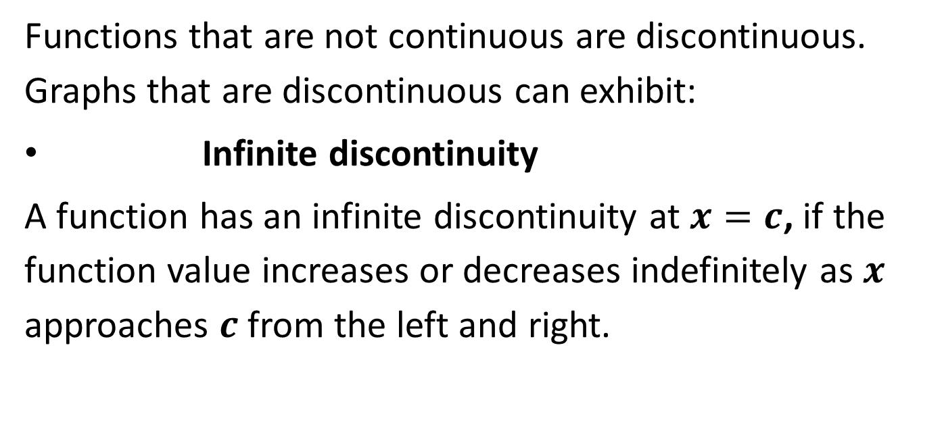
Continuity, End Behavior, and Limits
Functions that are not continuous are discontinuous. Graphs that are discontinuous can exhibit:
Infinite discontinuity
A function has an infinite discontinuity at $x=c$, if the function value increases or decreases indefinitely as $x$ approaches $c$ from the left and right.

Slide 6
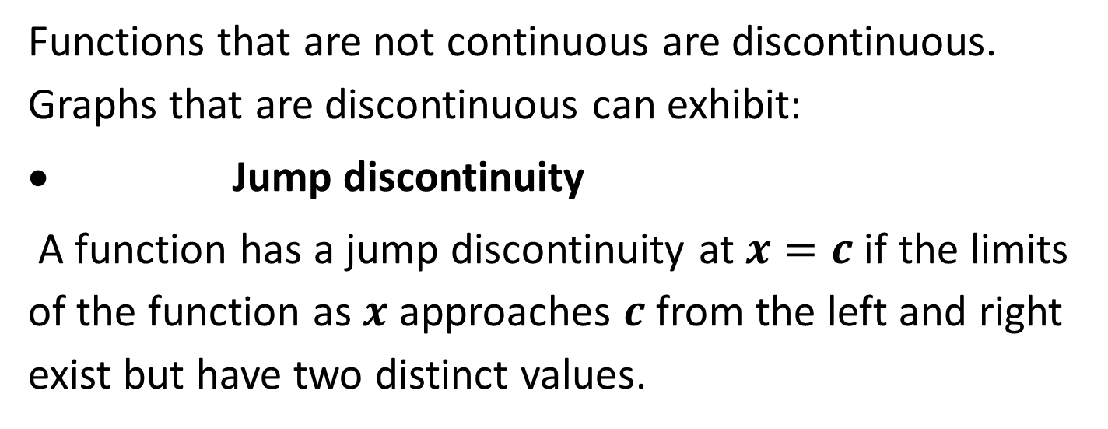
Continuity, End Behavior, and Limits
Functions that are not continuous are discontinuous. Graphs that are discontinuous can exhibit:
Jump discontinuity
A function has a jump discontinuity at $x=c$ if the limits of the function as $x$ approaches $c$ from the left and right exist but have two distinct values.

Slide 7
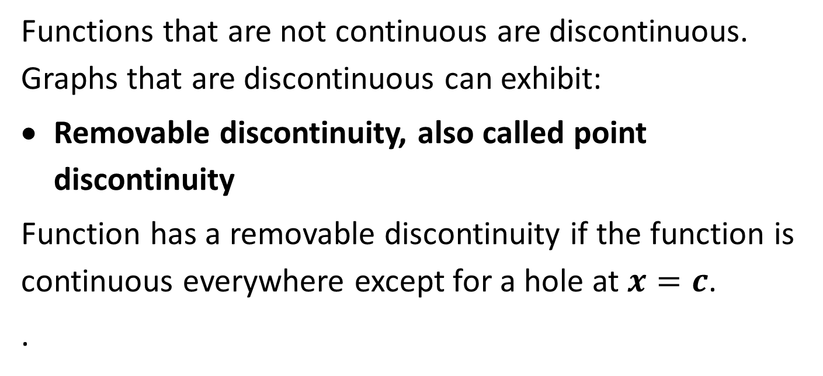
Continuity, End Behavior, and Limits
Functions that are not continuous are discontinuous. Graphs that are discontinuous can exhibit:
Removable discontinuity, also called point discontinuity
Function has a removable discontinuity if the function is continuous everywhere except for a hole at $x=c$.
.

Slide 8
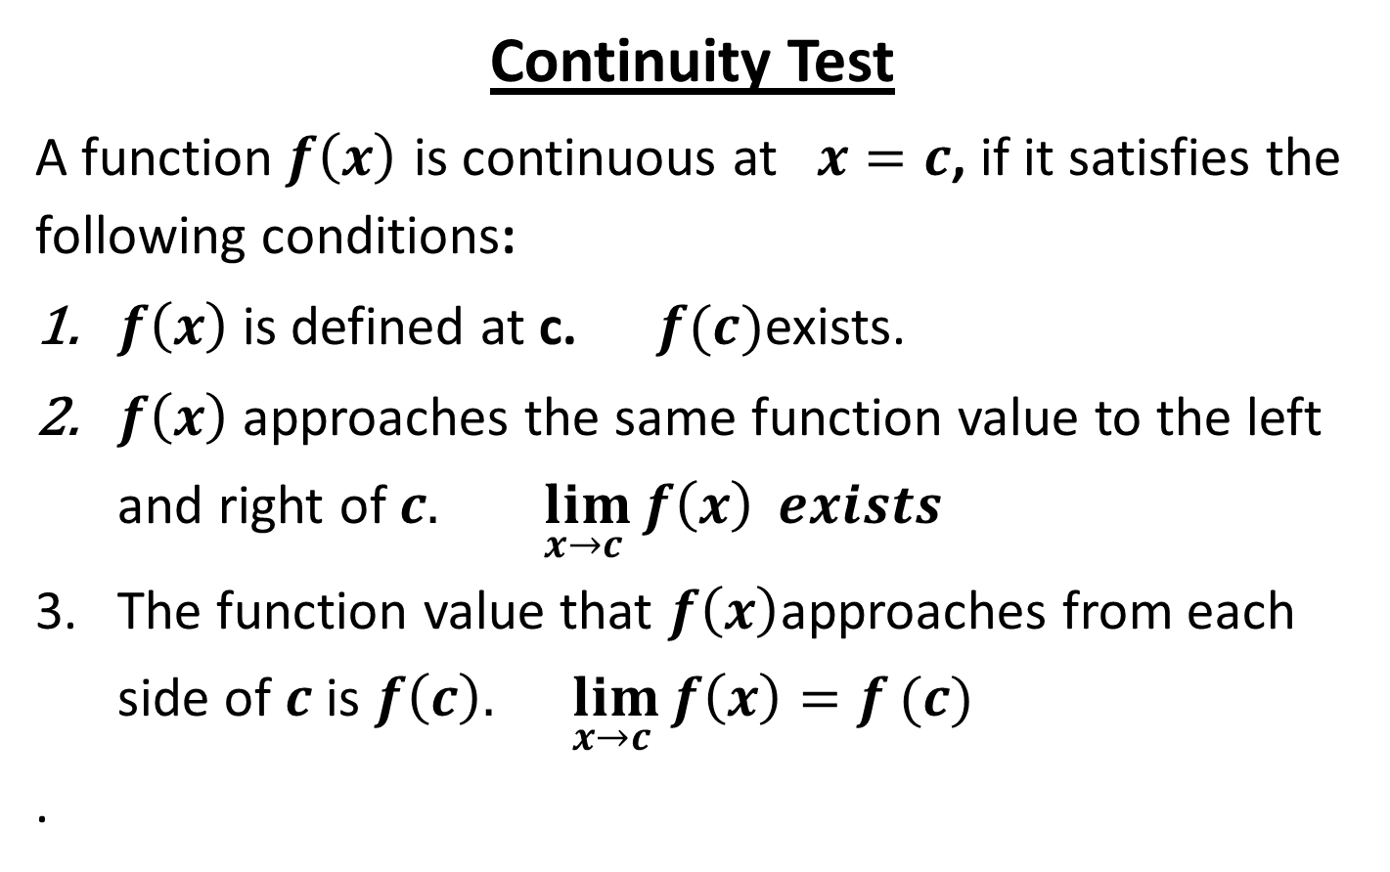
Continuity, End Behavior, and Limits
Continuity Test
A function$f\left(x\right)$ is continuous at $x=c$, if it satisfies the following conditions:
$f\left(x\right)$is defined at c. $f(c)$exists.
$f\left(x\right)$approaches the same function value to the left and right of $c.$ $\lim_{x→c }{f\left(x\right)} exists$
The function value that $f\left(x\right)$approaches from each side of $c$ is $f\left(c\right).$ $\lim_{x→c }{f\left(x\right)=f}(c)$
.

Slide 9

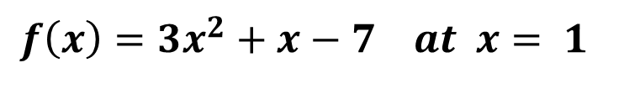
Continuity, End Behavior, and Limits
Sample Problem 1: Determine whether each function is continuous at the given x -values. Justify using the continuity test. If discontinuous, identify the type of discontinuity.
a.
$$f\left(x\right)={3x}^{2}+x−7 at x= 1$$

Slide 10
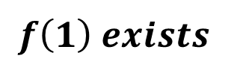
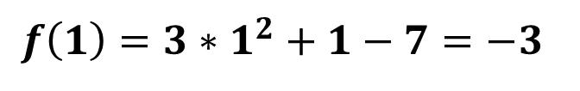
Continuity, End Behavior, and Limits
Sample Problem 1: Determine whether each function is continuous at the given x -values. Justify using the continuity test. If discontinuous, identify the type of discontinuity.
a.
$$f\left(x\right)={3x}^{2}+x−7 at x= 1$$
$$f\left(1\right)={3∗1}^{2}+1−7=−3$$
$$f\left(1\right) exists$$

Slide 11
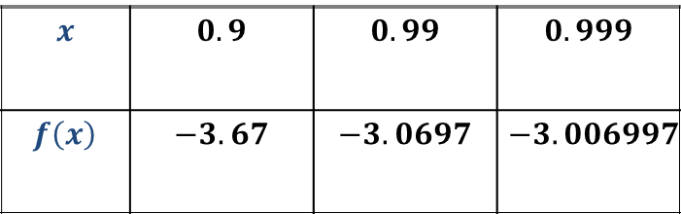
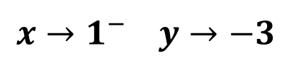
Continuity, End Behavior, and Limits
Sample Problem 1: Determine whether each function is continuous at the given x -values. Justify using the continuity test. If discontinuous, identify the type of discontinuity.
a.
$$f\left(x\right)={3x}^{2}+x−7 at x= 1$$
$$x→1^{−} y→−3$$
$$x$$ | $$0.9$$ | $$0.99$$ | $$0.999$$
$$f\left(x\right)$$ | $$−3.67$$ | $$−3.0697$$ | $$−3.006997$$

Slide 12
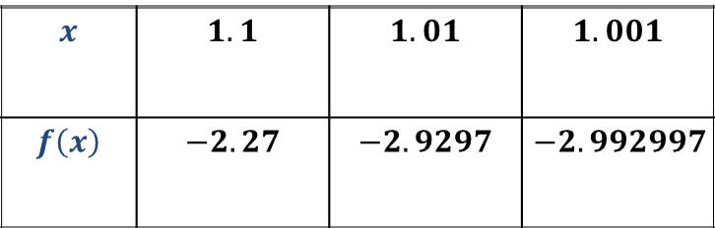
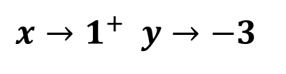
Continuity, End Behavior, and Limits
Sample Problem 1: Determine whether each function is continuous at the given x -values. Justify using the continuity test. If discontinuous, identify the type of discontinuity.
a.
$$f\left(x\right)={3x}^{2}+x−7 at x= 1$$
$$x→1^{+} y→−3$$
$$x$$ | $$1.1$$ | $$1.01$$ | $$1.001$$
$$f\left(x\right)$$ | $$−2.27$$ | $$−2.9297$$ | $$−2.992997$$

Slide 13
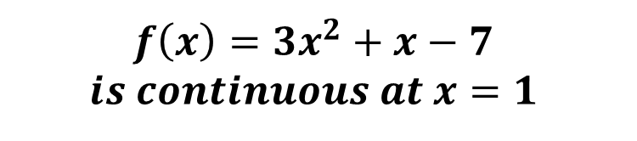
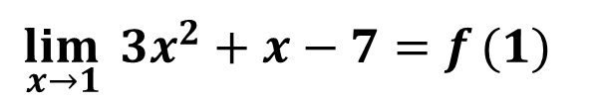
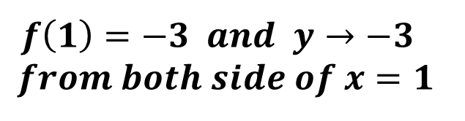
Continuity, End Behavior, and Limits
Sample Problem 1: Determine whether each function is continuous at the given x -values. Justify using the continuity test. If discontinuous, identify the type of discontinuity.
a.
$$f\left(x\right)={3x}^{2}+x−7 at x= 1$$
$$f\left(1\right)=−3 and y→−3$$
$$from both side of x=1$$
$$\lim_{x→1 }{{3x}^{2}+x−7=f}(1)$$
$$f\left(x\right)={3x}^{2}+x−7$$
$$is continuous at x=1$$

Slide 14
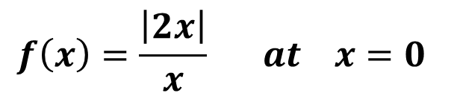
Continuity, End Behavior, and Limits
Sample Problem 1: Determine whether each function is continuous at the given x -values. Justify using the continuity test. If discontinuous, identify the type of discontinuity.
$$f\left(x\right)=\frac{\left|2x\right|}{x} at x=0$$
b.

Slide 15
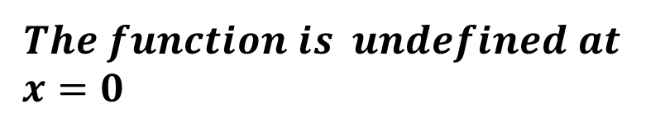
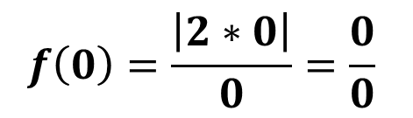
Continuity, End Behavior, and Limits
Sample Problem 1: Determine whether each function is continuous at the given x -values. Justify using the continuity test. If discontinuous, identify the type of discontinuity.
$$f\left(x\right)=\frac{\left|2x\right|}{x} at x=0$$
b.
$$f\left(0\right)=\frac{\left|2∗0\right|}{0}=\frac{0}{0}$$
$$The function is undefined at$$
$$x=0$$

Slide 16
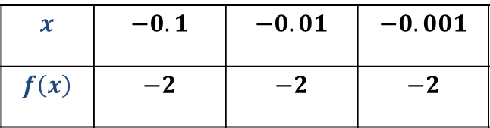
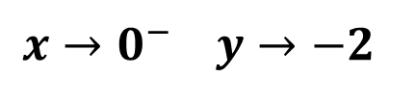
Continuity, End Behavior, and Limits
Sample Problem 1: Determine whether each function is continuous at the given x -values. Justify using the continuity test. If discontinuous, identify the type of discontinuity.
$$f\left(x\right)=\frac{\left|2x\right|}{x} at x=0$$
b.
$$x→0^{−} y→−2$$
$$x$$ | $$−0.1$$ | $$−0.01$$ | $$−0.001$$
$$f\left(x\right)$$ | $$−2$$ | $$−2$$ | $$−2$$

Slide 17
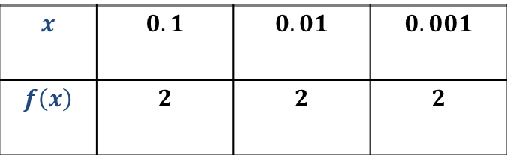
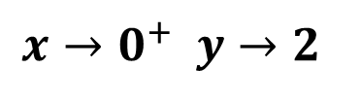
Continuity, End Behavior, and Limits
Sample Problem 1: Determine whether each function is continuous at the given x -values. Justify using the continuity test. If discontinuous, identify the type of discontinuity.
$$f\left(x\right)=\frac{\left|2x\right|}{x} at x=0$$
b.
$$x→0^{+} y→2$$
$$x$$ | $$0.1$$ | $$0.01$$ | $$0.001$$
$$f\left(x\right)$$ | $$2$$ | $$2$$ | $$2$$

Slide 18
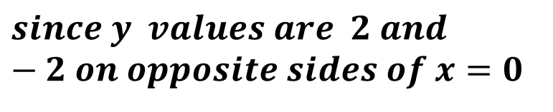
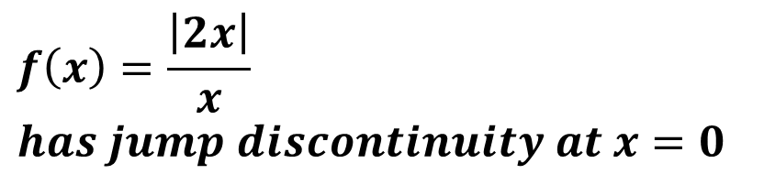
Continuity, End Behavior, and Limits
Sample Problem 1: Determine whether each function is continuous at the given x -values. Justify using the continuity test. If discontinuous, identify the type of discontinuity.
$$f\left(x\right)=\frac{\left|2x\right|}{x} at x=0$$
b.
$$f\left(x\right)=\frac{\left|2x\right|}{x}$$
$$has jump discontinuity at x=0$$
$$since y values are 2 and−2 on opposite sides of x=0$$

Slide 19
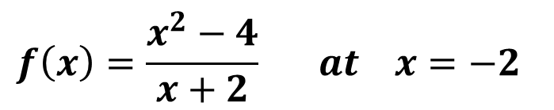
Continuity, End Behavior, and Limits
Sample Problem 1: Determine whether each function is continuous at the given x -values. Justify using the continuity test. If discontinuous, identify the type of discontinuity.
$$f\left(x\right)=\frac{x^{2}−4}{x+2} at x=−2$$
c.

Slide 20
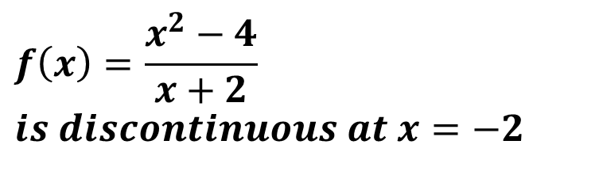
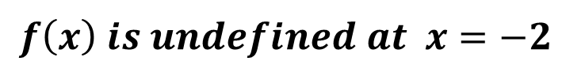
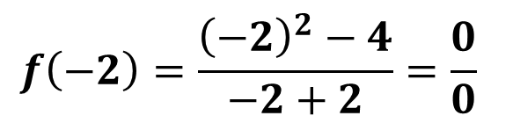
Continuity, End Behavior, and Limits
Sample Problem 1: Determine whether each function is continuous at the given x -values. Justify using the continuity test. If discontinuous, identify the type of discontinuity.
$$f\left(x\right)=\frac{x^{2}−4}{x+2} at x=−2$$
c.
$$f\left(−2\right)=\frac{{\left(−2\right)}^{2}−4}{−2+2}=\frac{0}{0}$$
$$f\left(x\right) is undefined at x=−2$$
$$f\left(x\right)=\frac{x^{2}−4}{x+2}$$
$$is discontinuous at x=−2$$

Slide 21
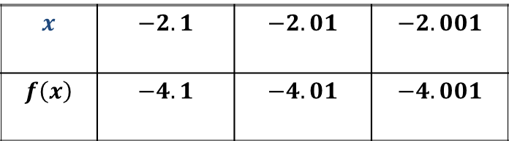
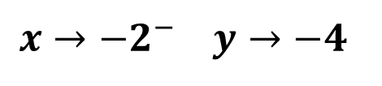
Continuity, End Behavior, and Limits
Sample Problem 1: Determine whether each function is continuous at the given x -values. Justify using the continuity test. If discontinuous, identify the type of discontinuity.
$$f\left(x\right)=\frac{x^{2}−4}{x+2} at x=−2$$
c.
$$x→{−2}^{−} y→−4$$
$$x$$ | $$−2.1$$ | $$−2.01$$ | $$−2.001$$
$$f\left(x\right)$$ | $$−4.1$$ | $$−4.01$$ | $$−4.001$$

Slide 22
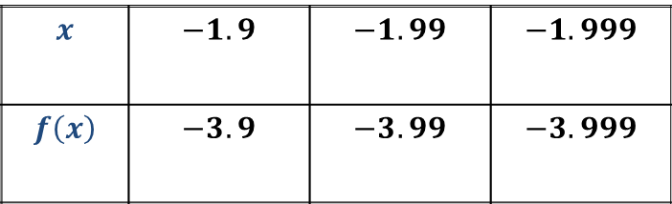
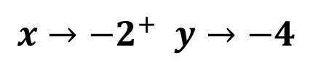
Continuity, End Behavior, and Limits
Sample Problem 1: Determine whether each function is continuous at the given x -values. Justify using the continuity test. If discontinuous, identify the type of discontinuity.
$$f\left(x\right)=\frac{x^{2}−4}{x+2} at x=−2$$
c.
$$x→{−2}^{+} y→−4$$
$$x$$ | $$−1.9$$ | $$−1.99$$ | $$−1.999$$
$$f\left(x\right)$$ | $$−3.9$$ | $$−3.99$$ | $$−3.999$$

Slide 23
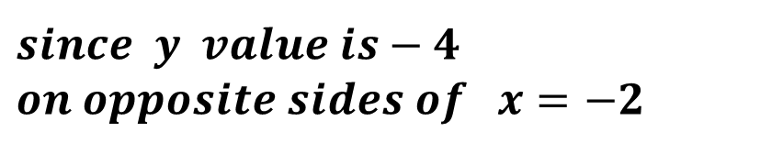
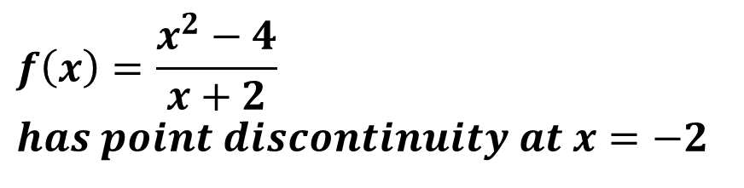
Continuity, End Behavior, and Limits
Sample Problem 1: Determine whether each function is continuous at the given x -values. Justify using the continuity test. If discontinuous, identify the type of discontinuity.
$$f\left(x\right)=\frac{x^{2}−4}{x+2} at x=−2$$
c.
$$f\left(x\right)=\frac{x^{2}−4}{x+2}$$
$$has point discontinuity at x=−2$$
$since$ $y value is−4$
$$on opposite sides of x=−2$$

Slide 24
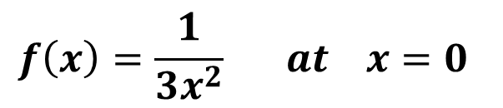
Continuity, End Behavior, and Limits
Sample Problem 1: Determine whether each function is continuous at the given x -values. Justify using the continuity test. If discontinuous, identify the type of discontinuity.
$$f\left(x\right)=\frac{1}{3x^{2}} at x=0$$
d.

Slide 25
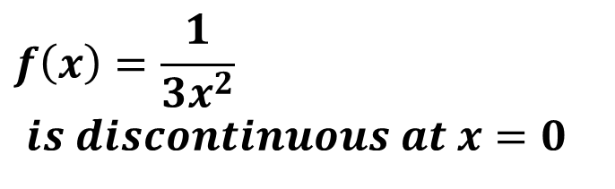
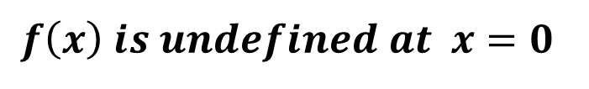
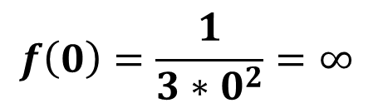
Continuity, End Behavior, and Limits
Sample Problem 1: Determine whether each function is continuous at the given x -values. Justify using the continuity test. If discontinuous, identify the type of discontinuity.
$$f\left(x\right)=\frac{1}{3x^{2}} at x=0$$
d.
$$f\left(0\right)=\frac{1}{3∗0^{2}}=∞$$
$$f\left(x\right) is undefined at x=0$$
$$f\left(x\right)=\frac{1}{3x^{2}}$$
$$is discontinuous at x=0$$

Slide 26
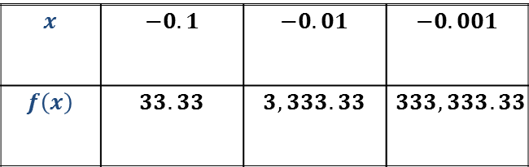
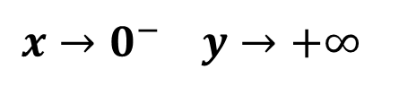
Continuity, End Behavior, and Limits
Sample Problem 1: Determine whether each function is continuous at the given x -values. Justify using the continuity test. If discontinuous, identify the type of discontinuity.
$$f\left(x\right)=\frac{1}{3x^{2}} at x=0$$
d.
$$x→0^{−} y→+∞$$
$$x$$ | $$−0.1$$ | $$−0.01$$ | $$−0.001$$
$$f\left(x\right)$$ | $$33.33$$ | $$3,333.33$$ | $$333,333.33$$

Slide 27
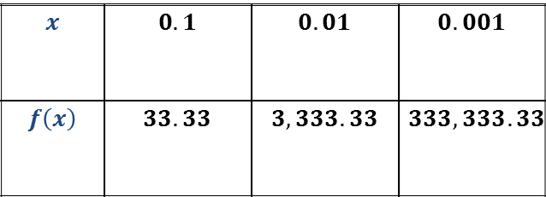
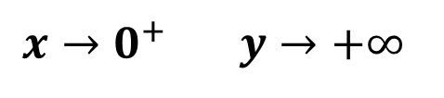
Continuity, End Behavior, and Limits
Sample Problem 1: Determine whether each function is continuous at the given x -values. Justify using the continuity test. If discontinuous, identify the type of discontinuity.
$$f\left(x\right)=\frac{1}{3x^{2}} at x=0$$
d.
$$x→0^{+} y→+∞$$
$$x$$ | $$0.1$$ | $$0.01$$ | $$0.001$$
$$f\left(x\right)$$ | $$33.33$$ | $$3,333.33$$ | $$333,333.33$$

Slide 28
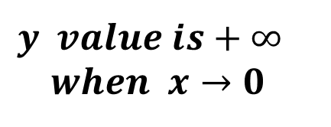
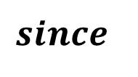
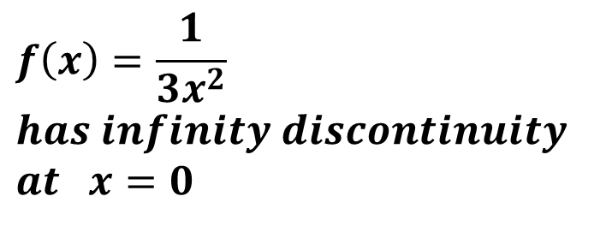
Continuity, End Behavior, and Limits
Sample Problem 1: Determine whether each function is continuous at the given x -values. Justify using the continuity test. If discontinuous, identify the type of discontinuity.
$$f\left(x\right)=\frac{1}{3x^{2}} at x=0$$
d.
$$f\left(x\right)=\frac{1}{3x^{2}}$$
$$has infinity discontinuity$$
$$at x=0$$
$$since$$
$$y value is+∞$$
$$when x→0$$

Slide 29
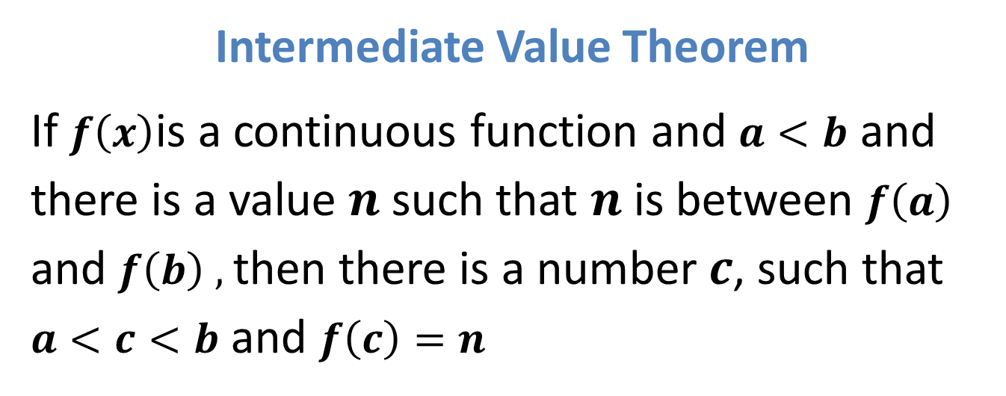
Continuity, End Behavior, and Limits
Intermediate Value Theorem
If $f\left(x\right)$is a continuous function and $a<b$ and there is a value $n$ such that $n$ is between $f\left(a\right)$ and $f\left(b\right) ,$then there is a number$c$, such that $a<c<b$ and $f\left(c\right)=n$

Slide 30
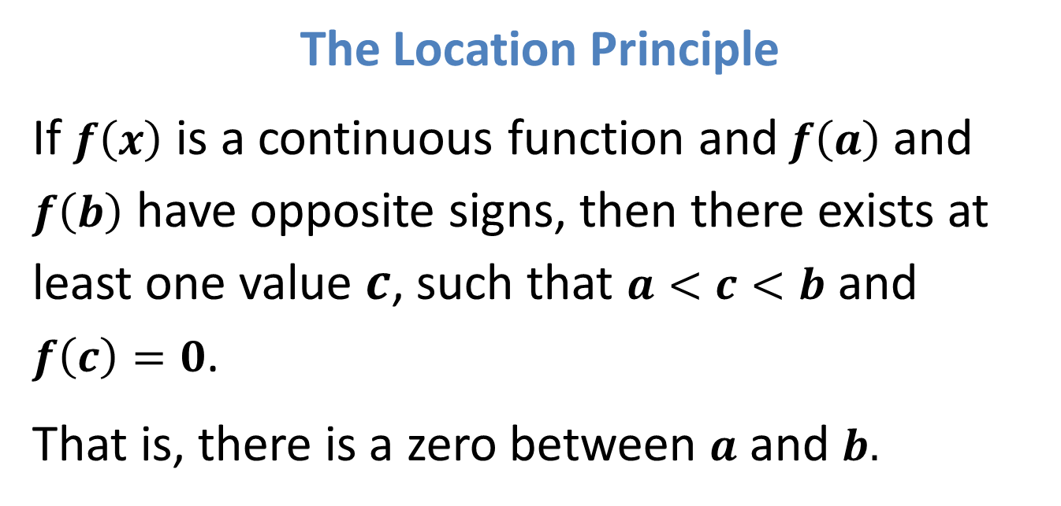
Continuity, End Behavior, and Limits
The Location Principle
If $f\left(x\right)$ is a continuous function and$f\left(a\right)$ and $f\left(b\right)$ have opposite signs, then there exists at least one value $c$, such that $a<c<b$ and $f\left(c\right)=0$.
That is, there is a zero between $a$ and $b.$

Slide 31
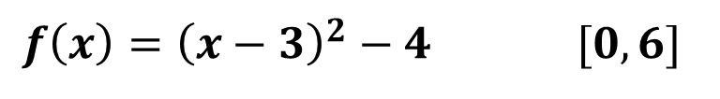
Continuity, End Behavior, and Limits
Sample Problem 2: Determine between which consecutive integers the real zeros of function are located on the given interval.
a.
$$f\left(x\right)={\left(x−3\right)}^{2}−4 [0,6]$$

Slide 32

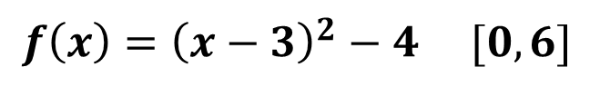






Continuity, End Behavior, and Limits
Sample Problem 2: Determine between which consecutive integers the real zeros of function are located on the given interval.
a.
$$f\left(x\right)={\left(x−3\right)}^{2}−4 [0,6]$$
$$x$$ | $$0$$ | $$1$$ | $$2$$ | $$3$$ | $$4$$ | $$5$$ | $$6$$
$$y$$ | $$5$$ | $$0$$ | $$−3$$ | $$−4$$ | $$−3$$ | $$0$$ | $$5$$
$f\left(0\right)$ is positive and $f\left(2\right)$ is negative,
$f\left(x\right) change sign in$ $0≤x≤2$
$f\left(4\right)$ is negative and $f\left(6\right)$ is positive,
$$f\left(x\right) change sign in 4≤x≤6$$
$f\left(x\right)$ has zeros in intervals:
$$0≤x≤2 and 4≤x≤6$$

Slide 33

Continuity, End Behavior, and Limits
End Behavior
The end behavior of a function describes what the $y$ -values do as $\left|x\right|$ becomes greater and greater.
When $x$ becomes greater and greater, we say that $x$ approaches infinity, and we write$x→+∞$.
When$x$ becomes more and more negative, we say that $x$ approaches negative infinity, and we write$x→−∞$.

Slide 34

Continuity, End Behavior, and Limits
The same notation can also be used with $y$ or $f\left(x\right)$ and with real numbers instead of infinity.
Left - End Behavior (as $x$ becomes more and more negative):$\lim_{x→−∞}{f\left(x\right)}$
Right - End Behavior (as $x$ becomes more and more positive): $\lim_{x→+∞}{f\left(x\right)}$
The $f\left(x\right)$ values may approach negative infinity, positive infinity, or a specific value.

Slide 35

Continuity, End Behavior, and Limits
Sample Problem 3: Use the graph of each function to describe its end behavior. Support the conjecture numerically.
a.
$$f\left(x\right)={−3x}^{3}+6x−1$$

Slide 36



Continuity, End Behavior, and Limits
Sample Problem 3: Use the graph of each function to describe its end behavior. Support the conjecture numerically.
a.
$$f\left(x\right)={−3x}^{3}+6x−1$$
From the graph, it appears that:
$f\left(x\right)→∞ as x→−∞$
$f\left(x\right)→−∞ as x→∞$
The table supports this conjecture.
$$x$$ | $$−{10}^{4}$$ | $$−{10}^{3}$$ | $$0$$ | $${10}^{3}$$ | $${10}^{4}$$
$$y$$ | $$3∗{10}^{12}$$ | $$3∗{10}^{9}$$ | $$−1$$ | -$3∗{10}^{9}$ | -$3∗{10}^{12}$

Slide 37

Continuity, End Behavior, and Limits
Sample Problem 3: Use the graph of each function to describe its end behavior. Support the conjecture numerically.
$$f\left(x\right)=\frac{4x−5}{4−x}$$
b.

Slide 38




Continuity, End Behavior, and Limits
Sample Problem 3: Use the graph of each function to describe its end behavior. Support the conjecture numerically.
$$f\left(x\right)=\frac{4x−5}{4−x}$$
b.
From the graph, it appears that:
$f\left(x\right)→−4 as x→−∞$
$f\left(x\right)→−4 as x→∞$
The table supports this conjecture.
$$x$$ | $$−{10}^{4}$$ | $$−{10}^{3}$$ | $$0$$ | $${10}^{3}$$ | $${10}^{4}$$
$$y$$ | $$−3.9989$$ | $$−3.9890$$ | $$−1.25$$ | $$−4.001$$ | $$−4.0011$$

Slide 39


Continuity, End Behavior, and Limits
Increasing, Decreasing, and Constant Functions
A function $f$ is increasing on an interval $I$ if and only if for every $a$ and $b$ contained in $I$, $\left(a\right)<f\left(b\right)$ , whenever $a<b$ .
A function $f$ is decreasing on an interval $I$ if and only if for every $a$ and $b$ contained in $I$, $f\left(a\right)>f\left(b\right)$ whenever $a<b$ .
A function $f$ remains constant on an interval $I$ if and only if for every $a$ and $b$ contained in $I$, $f\left(a\right)=f\left(b\right)$ whenever $a<b$ .
Points in the domain of a function where the function changes from increasing to decreasing or from decreasing to increasing are called critical points.

Slide 40

Continuity, End Behavior, and Limits
Sample Problem 4: Determine the interval(s) on which the function is increasing and the interval(s) on which the function is decreasing.
a.
$$f\left(x\right)=x^{2}−3x+2$$

Slide 41

Continuity, End Behavior, and Limits
Sample Problem 4: Determine the interval(s) on which the function is increasing and the interval(s) on which the function is decreasing.
a.
$$f\left(x\right)=x^{2}−3x+2$$
From the graph, it appears that:
A function $x^{2}−3x+2$ is decreasing for $x<1.5$
A function $x^{2}−3x+2$ is increasing for $x>1.5$

Slide 42

Continuity, End Behavior, and Limits
Sample Problem 4: Determine the interval(s) on which the function is increasing and the interval(s) on which the function is decreasing.
a.
$$f\left(x\right)=x^{2}−3x+2$$
The table supports this conjecture.
$$x$$ | $$−1$$ | $$0$$ | $$1$$ | $$1.5$$ | $$2$$ | $$3$$
$$y$$ | $$6$$ | $$2$$ | $$0$$ | $$−0.25$$ | $$−5.5$$ | $$2$$

Slide 43

Continuity, End Behavior, and Limits
Sample Problem 4: Determine the interval(s) on which the function is increasing and the interval(s) on which the function is decreasing.
$$f\left(x\right)=x^{3}−{\frac{1}{2}x}^{2}−10x+2$$
b.

Slide 44

Continuity, End Behavior, and Limits
Sample Problem 4: Determine the interval(s) on which the function is increasing and the interval(s) on which the function is decreasing.
$$f\left(x\right)=x^{3}−{\frac{1}{2}x}^{2}−10x+2$$
b.
From the graph, it appears that:
A function $x^{3}−{\frac{1}{2}x}^{2}−10x+2$
is increasing:
$x<−1.66 and x>2$
A function $x^{3}−{\frac{1}{2}x}^{2}−10x+2$
is decreasing:
$$−1.66<x<2$$

Slide 45

Continuity, End Behavior, and Limits
Sample Problem 4: Determine the interval(s) on which the function is increasing and the interval(s) on which the function is decreasing.
$$f\left(x\right)=x^{3}−{\frac{1}{2}x}^{2}−10x+2$$
b.
The table supports this conjecture.
$$x$$ | $$−2$$ | $$−1.66$$ | $$−1$$ | $$0$$ | $$2$$ | $$3$$
$$y$$ | $$12$$ | $$12.65$$ | $$10.5$$ | $$2$$ | $$−12$$ | $$−5.5$$

